Slide 1
Responsible AI Workshop Establishing your own Responsible AI journey for your (non-Generative vs. Generative) AI-powered solutions A companion presentation for the eponym stater guide for data engineers, data scientists, AI developers, and other AI practitioners to help putting Responsible AI into practice.
Version 1.0 - June 2024
Notes:
Module Objectives: After completing this module, you will be able to:
Understand the ethical implications of designing, developing, and using AI.
Comprehend what responsible AI means and why it is important in terms of guiding principles.
Learn from Microsoft's approach to responsible AI - our journey, our principles, our standards, and our safeguards.
Conduct (in a group) an assessment of the impact of responsible AI.
Identify Microsoft's responsible AI tools and toolkits to help operationalize responsible AI.

Slide 2





The world today…
AI solutions have significant potential to transform society and people’s lives
AI innovation is occurring at a rapid pace
Companies are accelerating adoption of AI
Societal and environmental expectations are evolving
Governments are regulating AI in response
Notes:
AI is here today, all around us, making our lives more convenient, more productive, and even more entertaining. It is making its way into some of the most important systems that affect us as individuals throughout our lives, whether it be healthcare, finance, education, or employment.
Organizations have recognized that AI is about to transform businesses and society. The advances in AI and the acceleration of its adoption are met with evolving societal expectations and increasing regulation in response to this evolution.
AI is complex, not just in defining it because it is not a single thing, but a constellation of technologies that can be used for very diverse purposes, with very different consequences.
AI presents unique challenges that we must address, and to take steps towards a better future, we must define new rules, standards, and practices.
Let's take a closer look at each of these aspects in the upcoming slides...

Slide 3
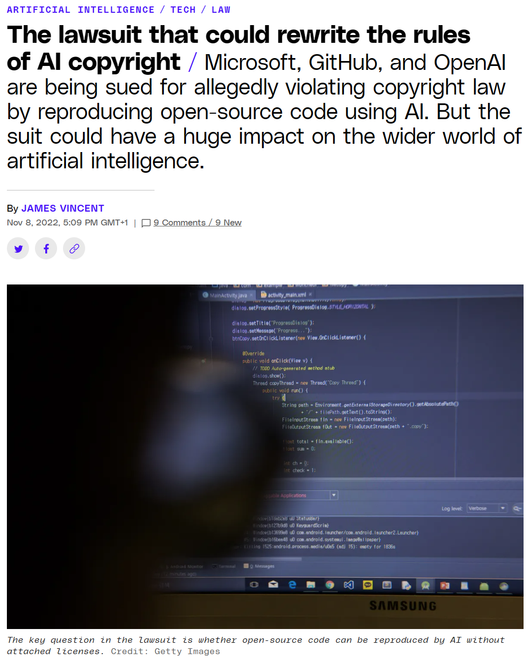
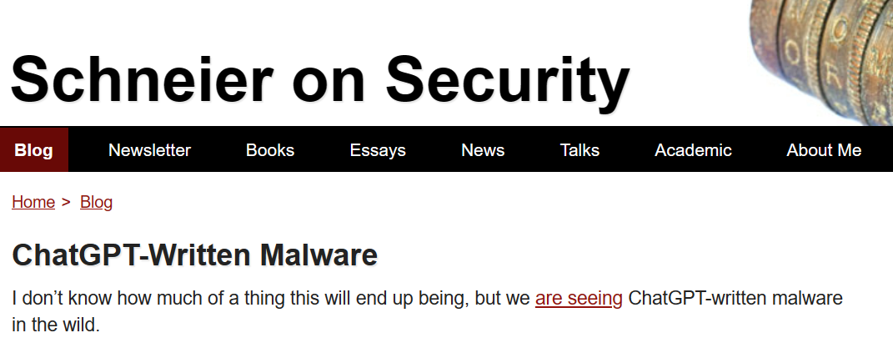
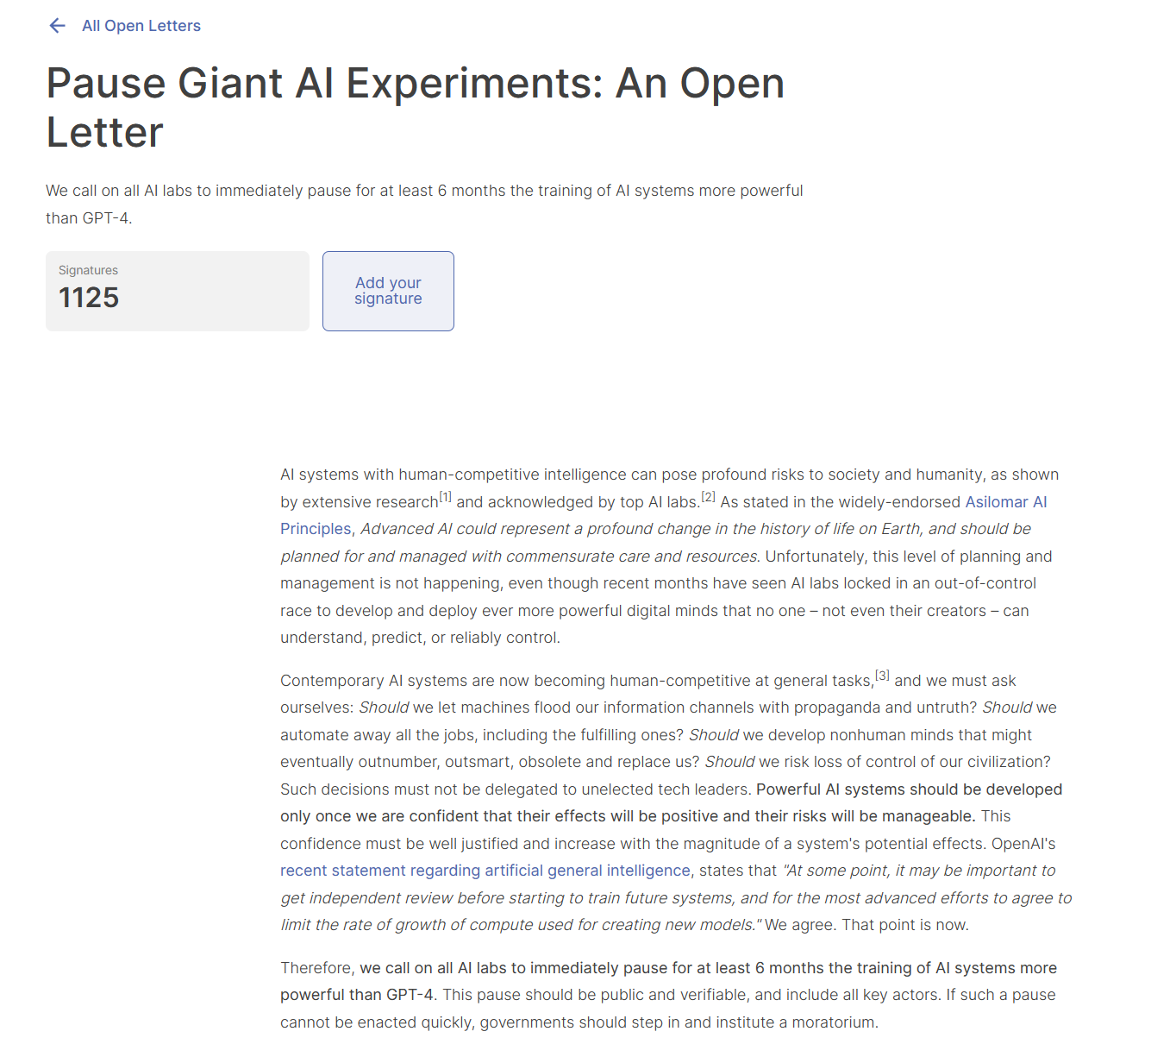
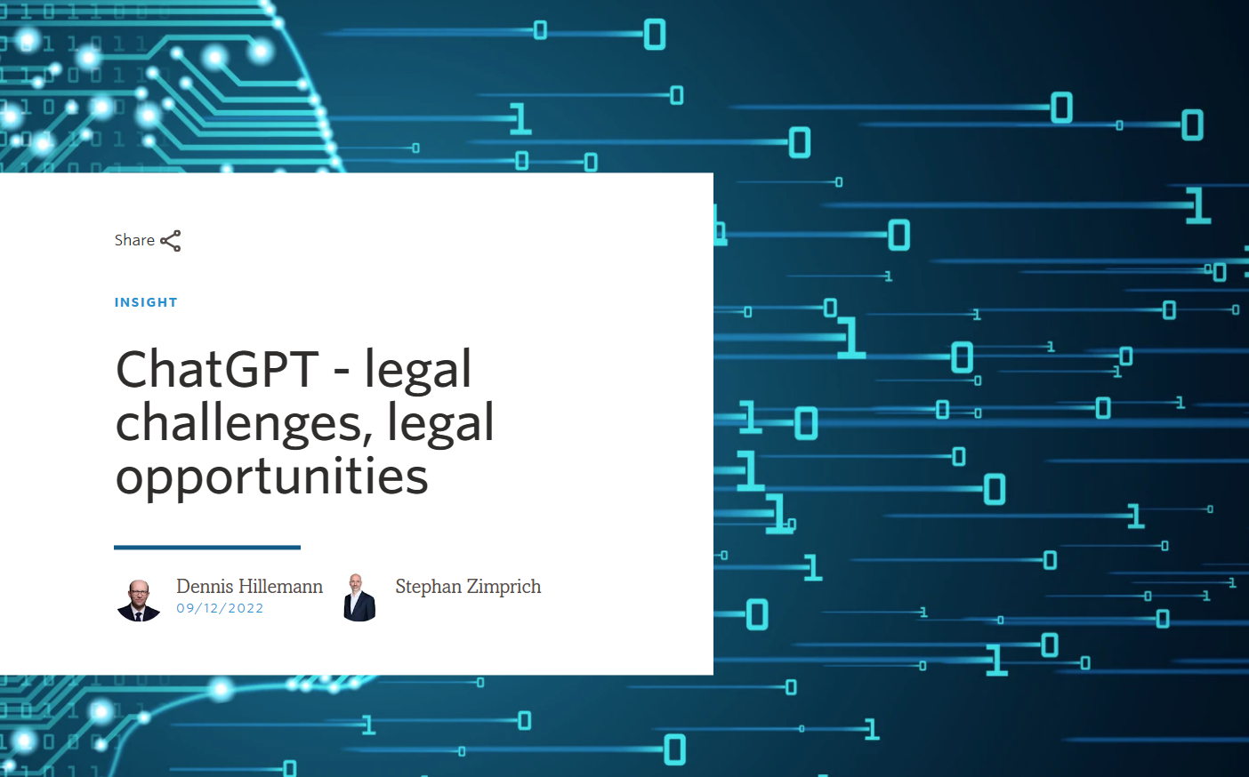
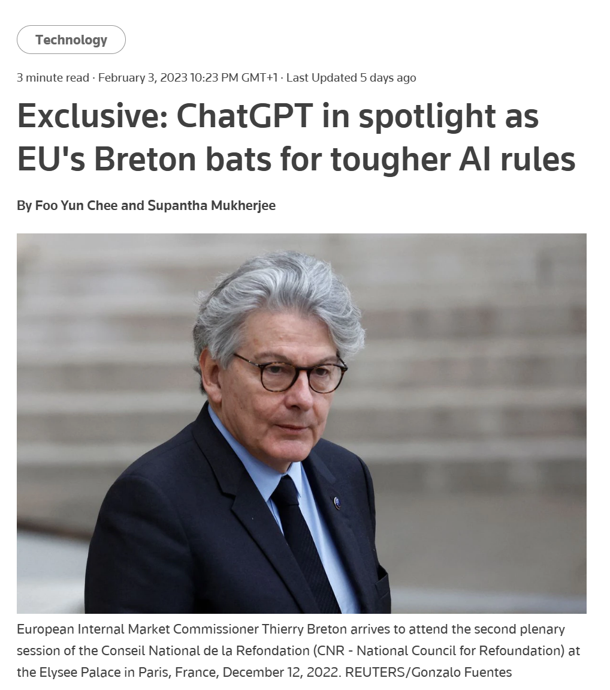
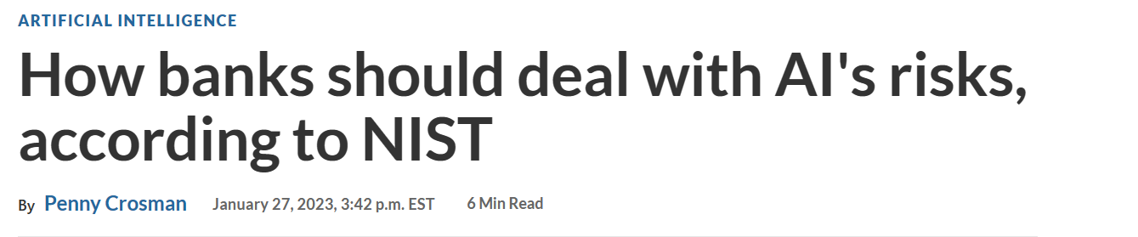
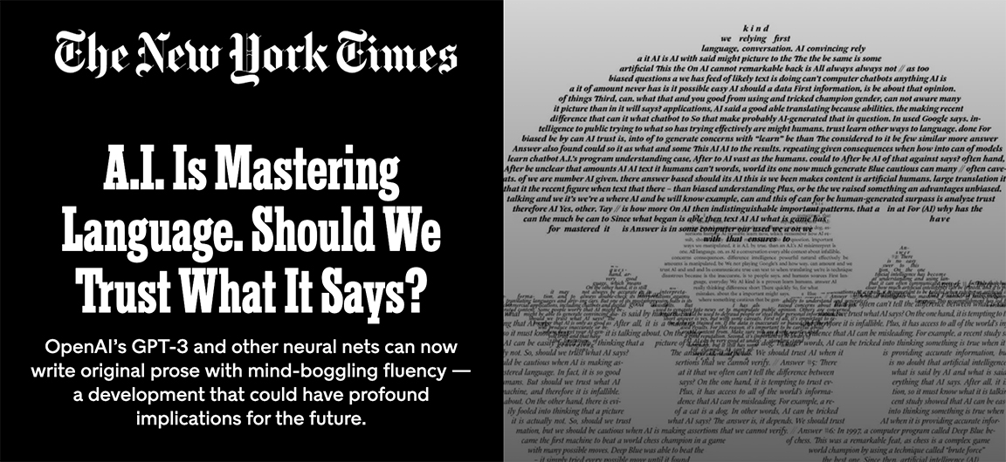
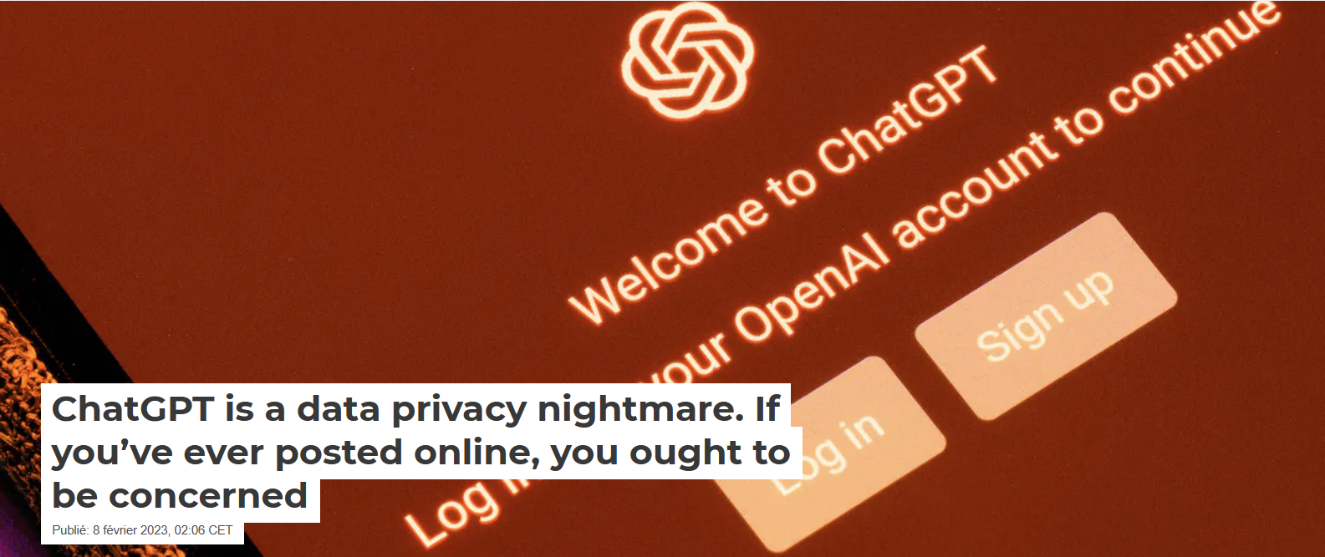
Societal expectations are increasing
“Something unknown is doing we don’t know what.”
Sir Arthur Eddington
New questions and issues also arise…
Notes:
AI is increasingly becoming a part of our lives. Cutting-edge technologies do not stay in laboratories; AI is increasingly used in applications that affect us as individuals and as members of society.
Societal expectations evolve based on the sociotechnical or societal impact of AI systems. The same goes for environmental expectations...
Every week, new headlines highlight concerns related to the use or misuse of AI. Societal expectations are increasing: more and more people within society are wondering if AI is trustworthy and which companies are innovating while taking their concerns into account.
Links:
Be careful with ChatGPT
What should humans do next?

Slide 4
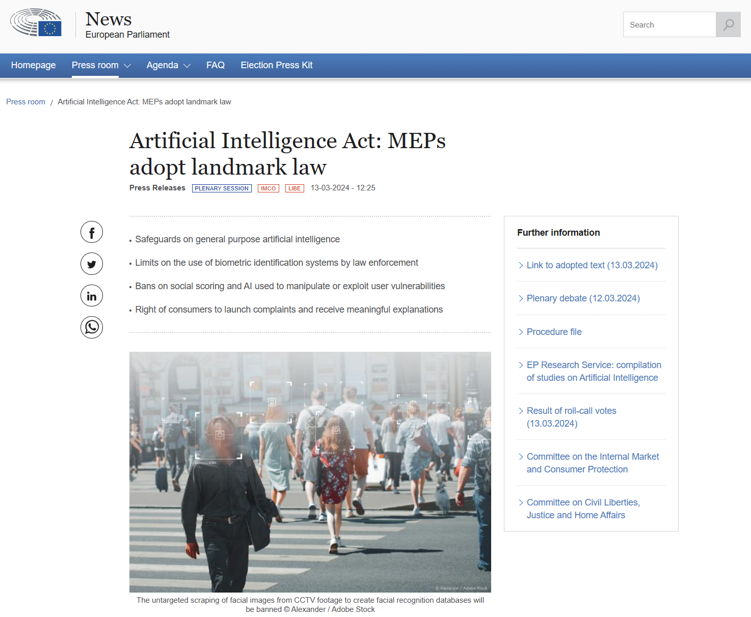
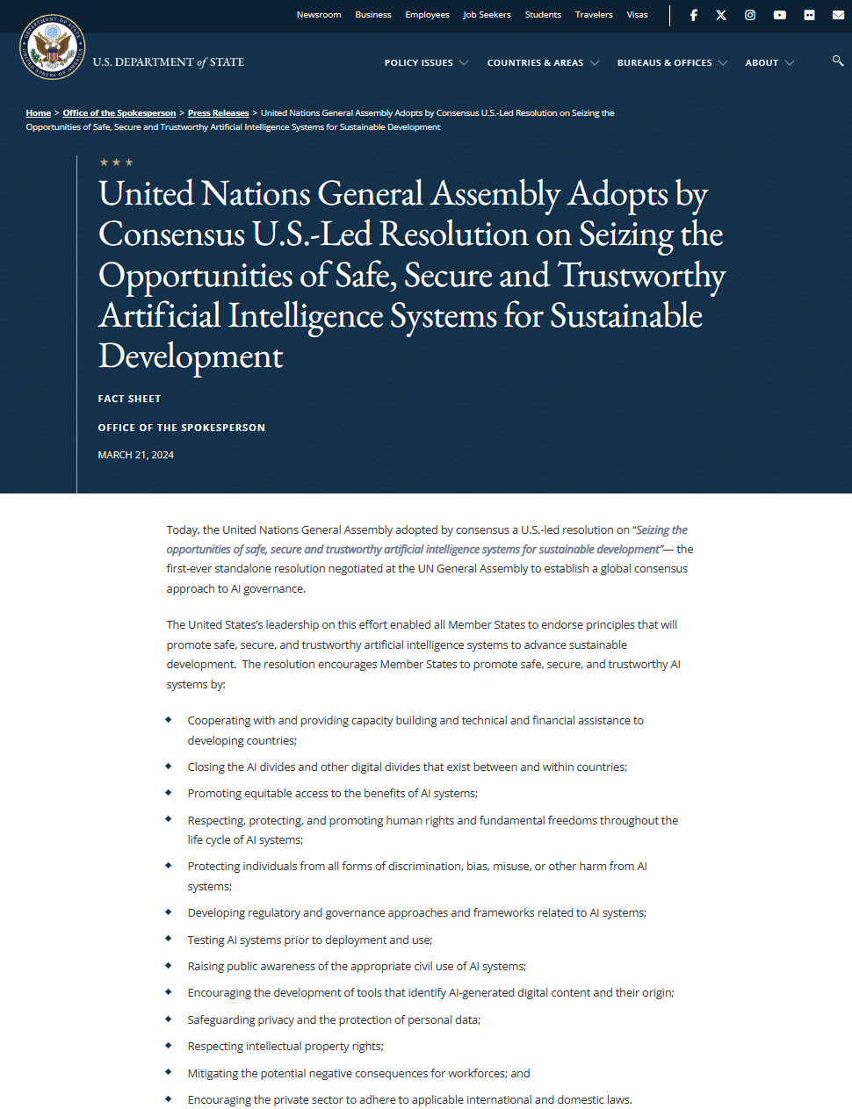
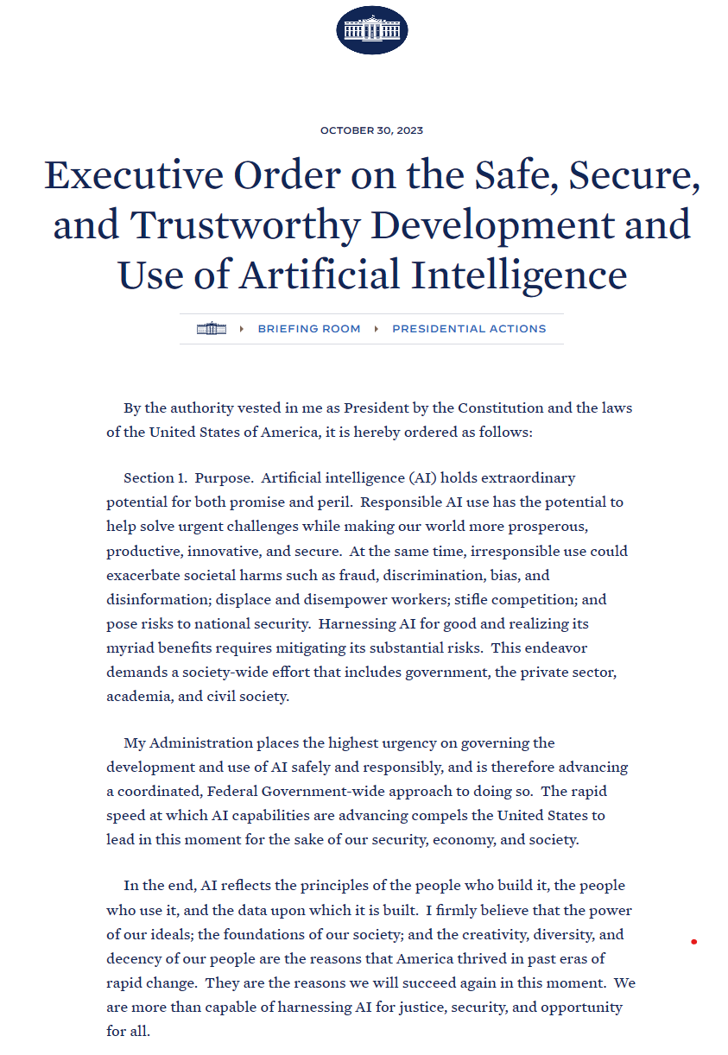
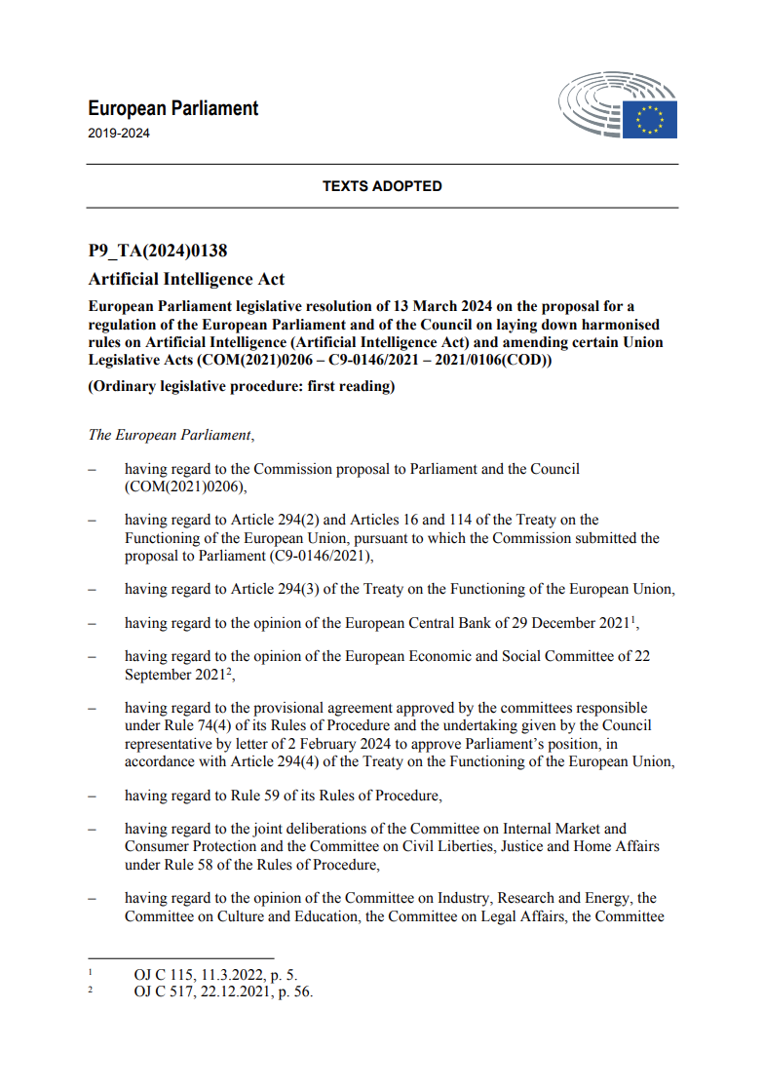
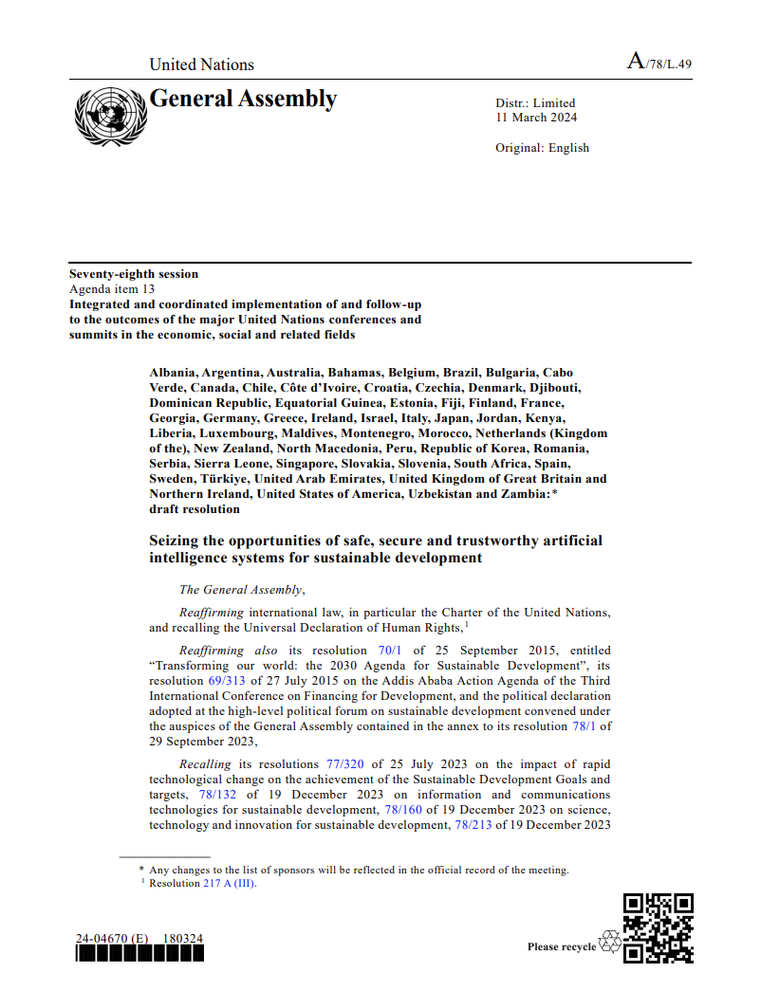
Notes:
Links:
Artificial Intelligence Act: MEPs adopt landmark law | News | European Parliament (europa.eu): https://www.europarl.europa.eu/news/en/press-room/20240308IPR19015/artificial-intelligence-act-meps-adopt-landmark-law
Texts adopted - Artificial Intelligence Act - Wednesday, 13 March 2024 (europa.eu): https://www.europarl.europa.eu/doceo/document/TA-9-2024-0138_EN.html
Executive Order on the Safe, Secure, and Trustworthy Development and Use of Artificial Intelligence | The White House:
United Nations General Assembly Adopts by Consensus U.S.-Led Resolution on Seizing the Opportunities of Safe, Secure and Trustworthy Artificial Intelligence Systems for Sustainable Development - United States Department of State: https://www.state.gov/united-nations-general-assembly-adopts-by-consensus-u-s-led-resolution-on-seizing-the-opportunities-of-safe-secure-and-trustworthy-artificial-intelligence-systems-for-sustainable-development/
n2406592.pdf (un.org)

Slide 5
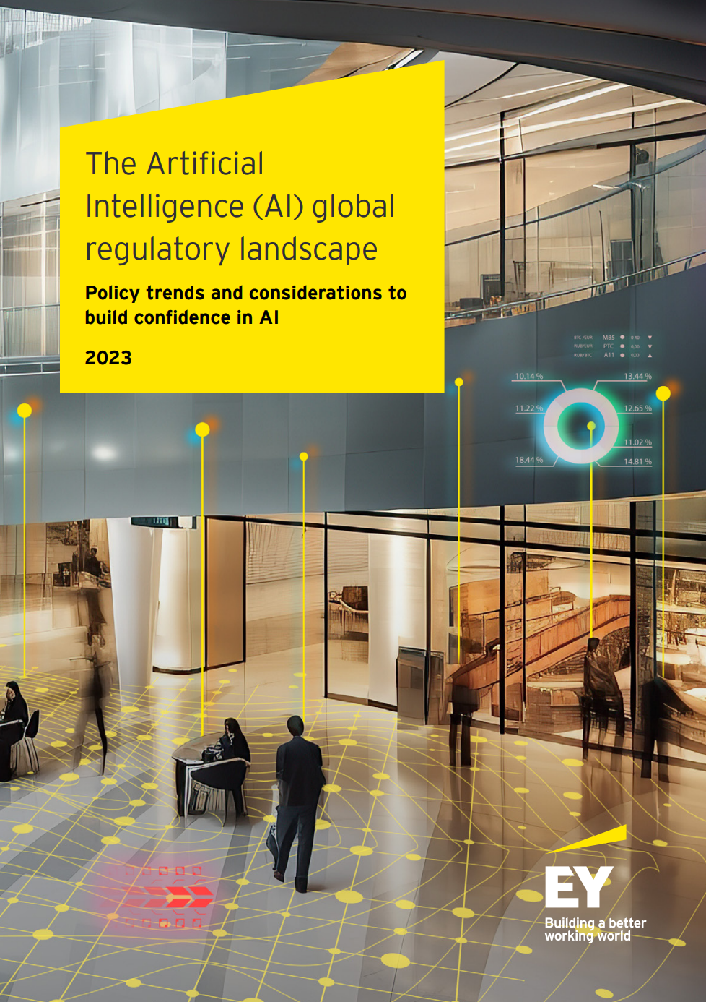
AI is advancing fast - policy & regulation of it may be, too
Governments plan to expand their use of AI, and regulation may be soon to follow.
Here are some things that may be a target for regulation:
National security risks: Governments are concerned that AI could lead to new threats to national security, such as cyberattacks or biological weapons.
Algorithmic biases: There is a worry about AI harming vulnerable populations through biases in algorithms, potentially leading to discrimination.
Workforce impact: The potential displacement of workers by AI is a significant concern, as it could have widespread socioeconomic effects.
Misinformation spread: The use of AI in spreading misinformation, e.g., deepfakes, is a critical issue, highlighting the need for regulation in sensitive use cases.
See also OECD’s live repository of National AI policies & strategies
AI Regulation Is Coming (hbr.org)
Notes:
In response to societal concerns, governments are regulating AI. Governments around the world are increasingly incorporating AI into various sectors, and this rise in AI usage heralds an imminent wave of regulatory measures.
One of the main concerns is the impact of AI on national security. The potential of AI to introduce new threats, such as sophisticated cyberattacks or advanced biological weapons, represents a significant challenge for existing security paradigms.
Another critical area is the issue of algorithmic bias. The concern here is the unintentional harm AI could cause to vulnerable groups due to the inherent biases in its algorithms. This could lead to discrimination and exacerbate social inequalities, highlighting the need for careful scrutiny and regulation of AI systems.
The workforce is also at a crossroads with the advent of AI. The replacement of human workers by AI and automation technologies is more than a mere probability: it is a reality that could have significant socio-economic implications. This change requires a thoughtful approach to manage the transition and mitigate potential negative effects on employment.
Regulatory and policy actions on AI in 2023:
January 2023
January 2023 The NIST publishes the AI Risk Management Framework 1.0, along with a series of resources.
March 2023
The Canadian government publishes the "companion document" to the AI and Data Act (Bill C-27).
The UK publishes its "pro-innovation" white paper on AI regulation.
The Italian data protection authority temporarily bans OpenAI's ChatGPT.
May 2023
The "AI Bill" 2338/2023 is introduced to the Senate, proposing a risk-based approach
June 2023
After the European Parliament's agreement, the "trilogue" negotiations begin.
August 2023
China's "interim measures" for the administration of generative AI services come into effect.
October 2023
UN Secretary-General António Guterres launches the UN Advisory Council on AI.
The G7 leaders' statement on the Hiroshima process for AI, including "guiding principles".
President Biden signs the executive order on "safe, secure, and trustworthy development and use of AI".
November 2023
World leaders sign the Bletchley Declaration, following the UK summit on AI security.
December 2023
European leaders announce a political agreement on the key elements of European legislation on artificial intelligence.
The US government, for example, plans to significantly increase its reliance on artificial intelligence, but it is years behind on policies to acquire and responsibly use technology from the private sector.
The Organization for Economic Co-operation and Development (OECD) and Microsoft have partnered on topics such as cybersecurity, and the OECD offers live tracking of the latest AI policies by country, which you can use to stay informed about changes
Links :
OECD’s live repository of National AI policies & strategies: https://oecd.ai/en/dashboards/overview
AI Regulation Is Coming (hbr.org): https://hbr.org/2021/09/ai-regulation-is-coming

Slide 6
Guiding principles for Responsible AI

Slide 7
Some definitions to get started on this journey ;-) Ethics & Morals
Etymology
”Ethics" comes from the Greek ethos, meaning "mores", "ways of living and acting".
"Morale" comes from the Latin mos (genitive moris), more often used in the plural mores, meaning "mores", "ways of living and acting".
Comte-Sponville gives the following respective definitions:
“I would morals the normative and imperative discourse that results from the opposition of Good and Evil considered as universal and absolute values. It is the sum of our duties. Morals answers the question "What must I do? It is intended to be one and universal. It tends towards virtue and culminates in holiness.
I would call ethics any normative but non-imperative discourse (without any imperative other than hypothetical, i.e., without imperative in the usual sense of the term) that results from the opposition of good and bad considered as relative values. It is the reflective whole of our desires. Ethics answers the question "How should we live? It is always specific to an individual or a group. It is an art of living. It tends towards happiness and culminates in wisdom.”
Notes:
The two words "ethics" and "morality" come from two words, one Greek, the other Latin, which are the pure and simple translation of each other whether one was to go from Greek to Latin or from Latin to Greek.
Although their etymology does not distinguish them, we will refer in this workshop to the concept of ethics in the sense defined by André Comte-Sponville, a French philosopher known for his work on materialist ethics and morality, where he defines morality as the set of our duties, the obligations that we impose on ourselves, considered as good in an absolute way, independently of any reward or sanction expected, and even of any hope, while he defines ethics as an argued reflection on moral values.
In other words, "morality commands, ethics recommends". Like him, we will make a distinction between "ethics" and "morality".
"I will call morality the normative and imperative discourse that results from the opposition of Good and Evil considered as universal and absolute values. It is the set of our duties. Morality answers the question 'What should I do?'. It wants to be one and universal. It tends towards virtue and culminates in sanctity.
I will call ethics any normative but not imperative discourse (without any imperative other than hypothetical, therefore without imperative in the usual sense of the term) that results from the opposition of good and bad considered as relative values. It is the thoughtful set of our desires. An ethic answers the question 'How to live?'. It is always particular to an individual or a group. It is an art of living. It tends most often towards happiness and culminates in wisdom. “

Slide 8
Some definitions to get started on this journey ;-) Ethics
While formal moral frameworks drawn from philosophy and religion are important, they form only one aspect of a cross-cultural study of ethics.
Every culture has a living system of ethics, which includes formal moral frameworks, but also many other factors such as politics, history, law, customs, common sense and individual experience.
These multiple aspects of culture and living ethics are interrelated. In other words, ethics and culture are inseparable.
To understand ethics, we need to understand culture, and vice versa. Ethics and culture must be considered together as interwoven strands of social DNA.
Notes:
Each culture has its own beliefs, references and norms, which reflect in ethics.

Slide 9

“I would argue that perhaps the most productive debate we can have isn’t one of good versus evil:
The debate should be about the values instilled in the people and institutions creating this technology.”
- Satya Nadella
Chief Executive Officer, Microsoft
Notes:
We recognize that each person, each company, and each region has its own beliefs and standards that must be reflected in its own AI journey.
What I want to share with you in the next slides is our perspective and approach on how to translate our principles into enterprise-wide practices. This approach is focused on proactively establishing safeguards for AI systems, so we can ensure that their risks are anticipated and mitigated, and their benefits are maximized.

Slide 10
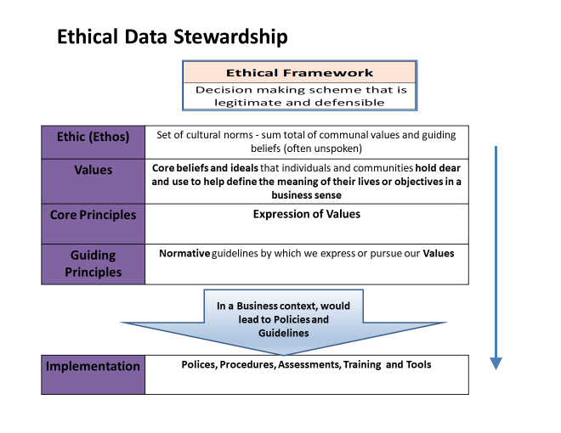
Some definitions to get started on this journey ;-) Ethics

Slide 11

Why adopting guiding principles?
“The more powerful the tool, the greater the benefit or damage it can cause…
Technology innovation is not going to slow down. The work to manage it needs to speed up.”
- Brad Smith
President and Chief Legal Officer, Microsoft
Notes:
This quote from Tools and Weapons, a book published by Brad Smith and Carol Ann Browne in September 2019, sums up the situation quite well.
AI systems include not only the technology but also the people who will use them, the people who will be affected by them, and the environment in which they are deployed. To create a “Responsible AI-ready" AI system it is necessary to understand its potential effects - both beneficial and harmful - on people and society, and to take appropriate steps to mitigate the anticipated harmful effects and prepare responses to unforeseen effects.
To quote another passage from the book "Tools and Weapons," "when your technology changes the world, you bear a responsibility to help address the world you have helped create," and that's how we embarked de facto on a journey towards responsible AI.

Slide 12
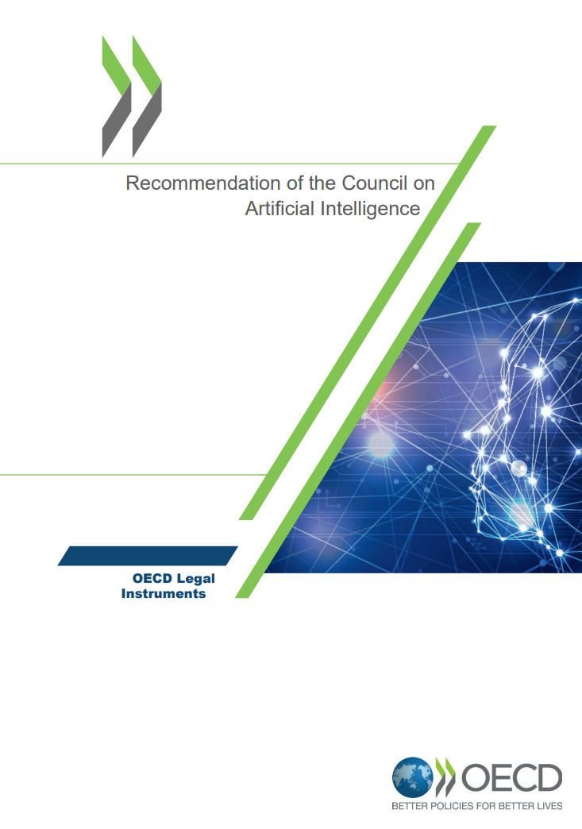

OECD Principles for responsible stewardship of trustworthy AI
Set standards for AI that are practical and flexible enough to stand the test of time.
Promote use of AI that is innovative and trustworthy and that respects human rights and democratic values:
Inclusive growth, sustainable development and well-being
Human-centred values and fairness
Transparency and explainability
Robustness, security and safety
Accountability
See OECD AI Principles
Notes:
The OECD has facilitated discussions on these topics and adopted principles of responsible AI in May 2019.
They focus on how governments and other actors can shape a human-centered approach to trustworthy AI. As an OECD legal instrument, they represent a common aspiration for the countries that adhere to it.
In June 2020, the G20 adopted AI principles centered on humans, which are based on the OCDE’s AI principles.
Links:
https://legalinstruments.oecd.org/en/instruments/OECD-LEGAL-0449
Inclusive growth, sustainable development and well-being (OECD AI Principle) - OECD.AI
Human-centred values and fairness (OECD AI Principle) - OECD.AI
Transparency and explainability (OECD AI Principle) - OECD.AI
Principle on robustness, security and safety (OECD AI Principle) - OECD.AI
Accountability (OECD AI Principle) - OECD.AI

Slide 13
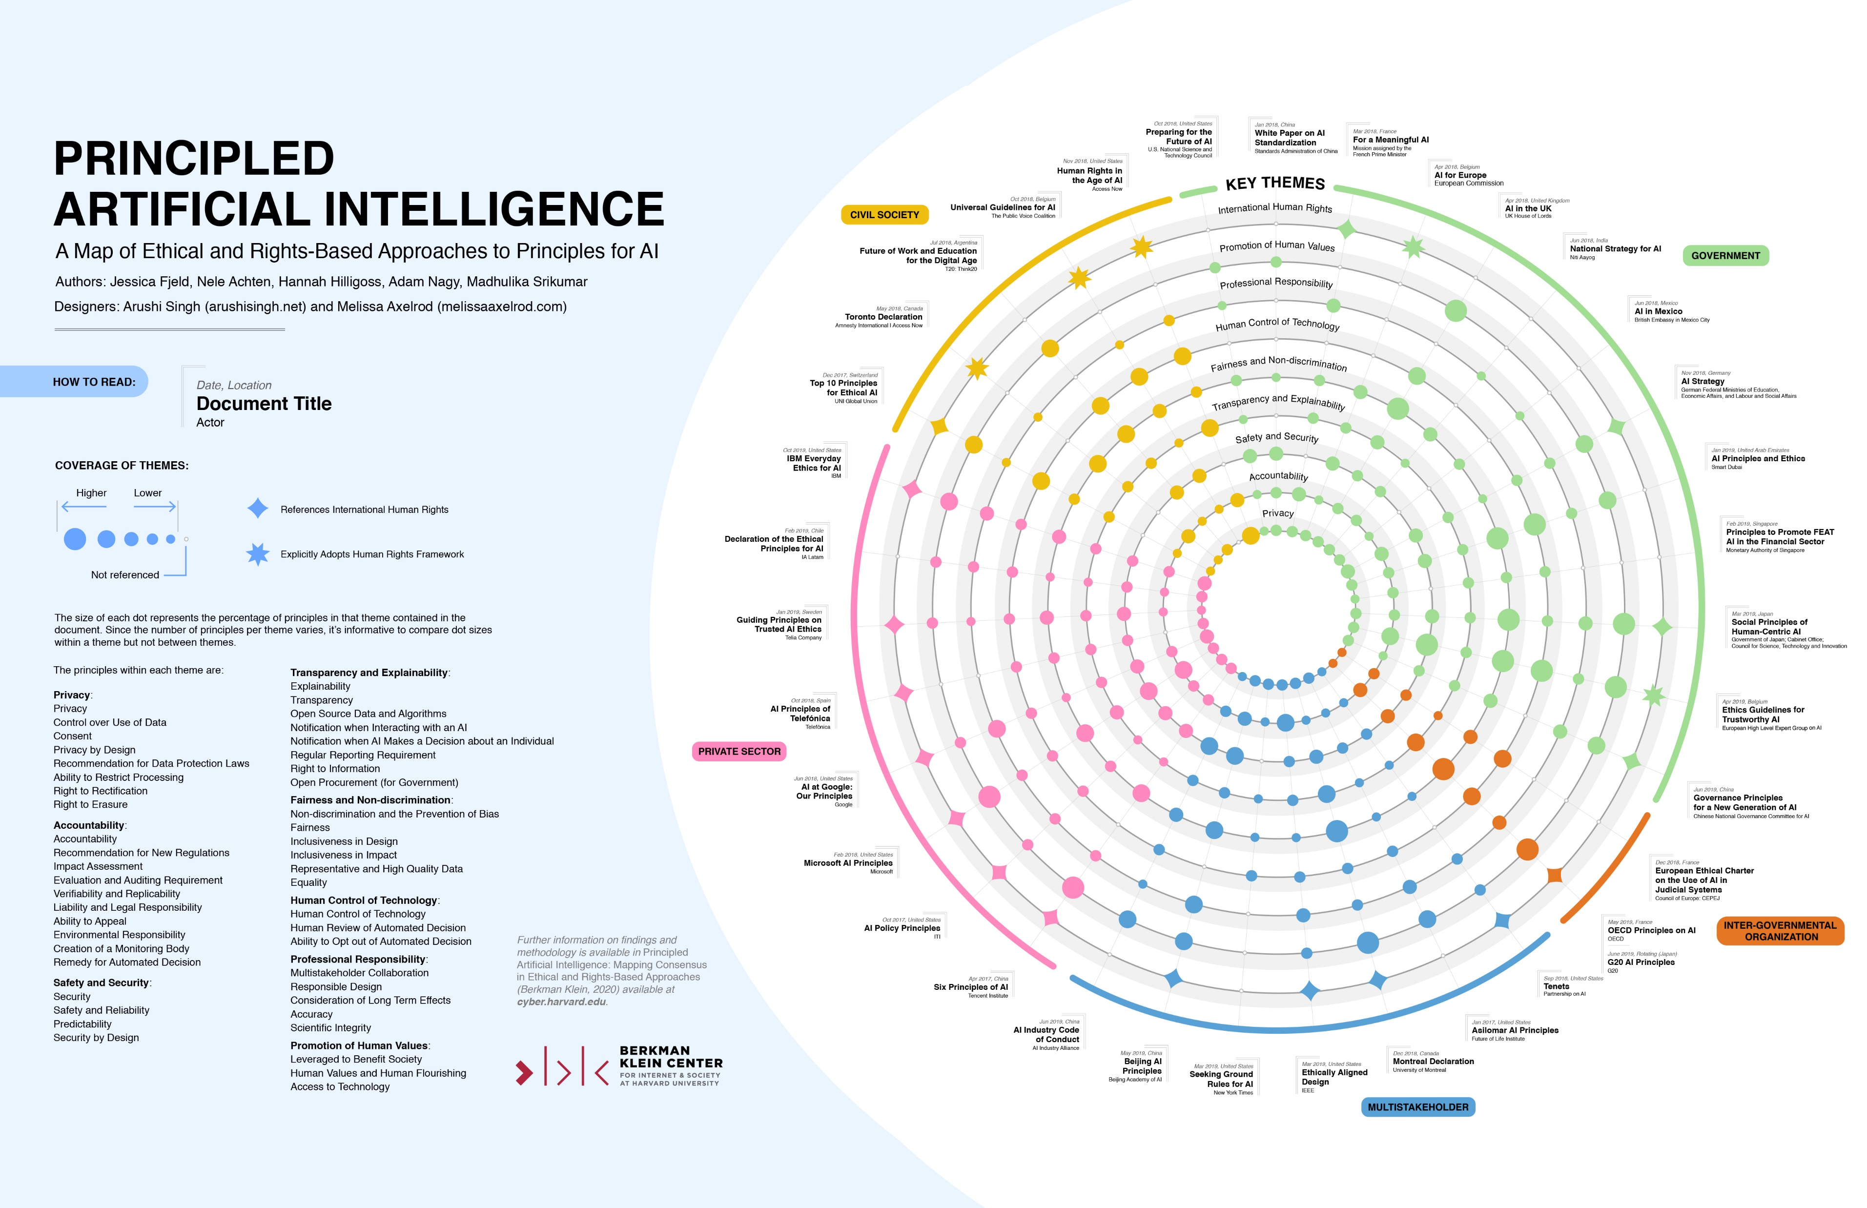
Notes:
Over the past few years, principles for the responsible development of AI have proliferated, and for the most part, there is overwhelming agreement on the need to prioritize issues such as transparency, fairness, accountability, privacy protection, and security. Here you can find a Venn diagram from Harvard University that visually compares thirty-six significant documents on AI principles, including the six principles that we believe should guide the development and use of AI.
While principles are necessary, having them is not enough. The hard and essential work begins when we strive to turn these principles into practices.
Links:
Principled Artificial Intelligence | Berkman Klein Center (harvard.edu): https://cyber.harvard.edu/publication/2020/principled-ai

Slide 14



But guiding principles alone are not enough…
…Principles are:
Not
Self-executing
Incapable of
Answering the question: “How?”
Open to
interpretation
How to translate them into practice (at scale)?
Notes:
That being said, we recognize that principles are not enough.
For example, they do not apply themselves. Just because you wish and believe that an AI system should be fair or inclusive does not mean it will be.
Principles are also open to interpretation. If I asked everyone reading this what fairness means, we would probably get as many different answers as there are people reading.
Principles also do not answer the question of how to implement them.
What needs to be done, then, is to put these principles into practice. How do we achieve this? That's what I propose to see now…

Slide 15

As an illustration: Microsoft approach to Responsible AI What we’ve learned and share as a company
Notes:
Links :
https://www3.weforum.org/docs/WEF_Responsible_Use_of_Technology_2021.pdf

Slide 16
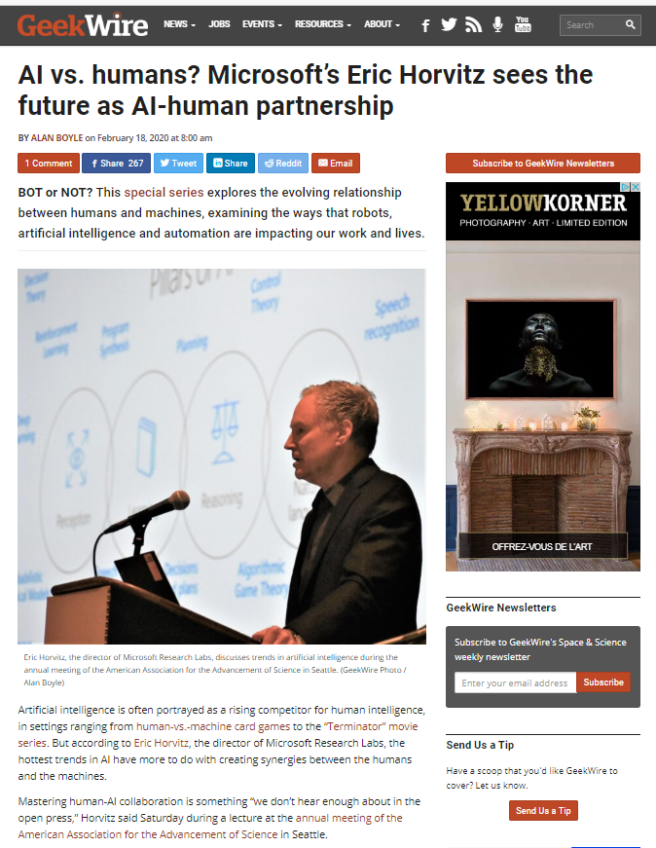
What is Microsoft’s approach to AI?
Designing AI to augment human capabilities
In favor of a human-IA partnership
Designing AI that is accessible to all of us
In line with our commitment to respect human rights
“We are pursuing AI to empower every person and every institution .. so that they can go on to solve the most pressing problems of our society and our economy.”
--Satya Nadella
The Partnership of the Future
Notes:
Links:
AI vs. humans? Microsoft's Eric Horvitz sees it as AI plus humans (geekwire.com) https://www.geekwire.com/2020/ai-vs-humans-microsofts-eric-horvitz-sees-future-ai-human-partnership/
Microsoft CEO Satya Nadella: Humans and A.I. can work together to solve society’s challenges. (slate.com) https://slate.com/technology/2016/06/microsoft-ceo-satya-nadella-humans-and-a-i-can-work-together-to-solve-societys-challenges.html
Human rights statement | Microsoft CSR https://www.microsoft.com/en-US/corporate-responsibility/human-rights-statement?activetab=pivot_1%3aprimaryr5
What is Microsoft's Approach to AI? | Microsoft Source https://news.microsoft.com/source/features/ai/microsoft-approach-to-ai/

Slide 17
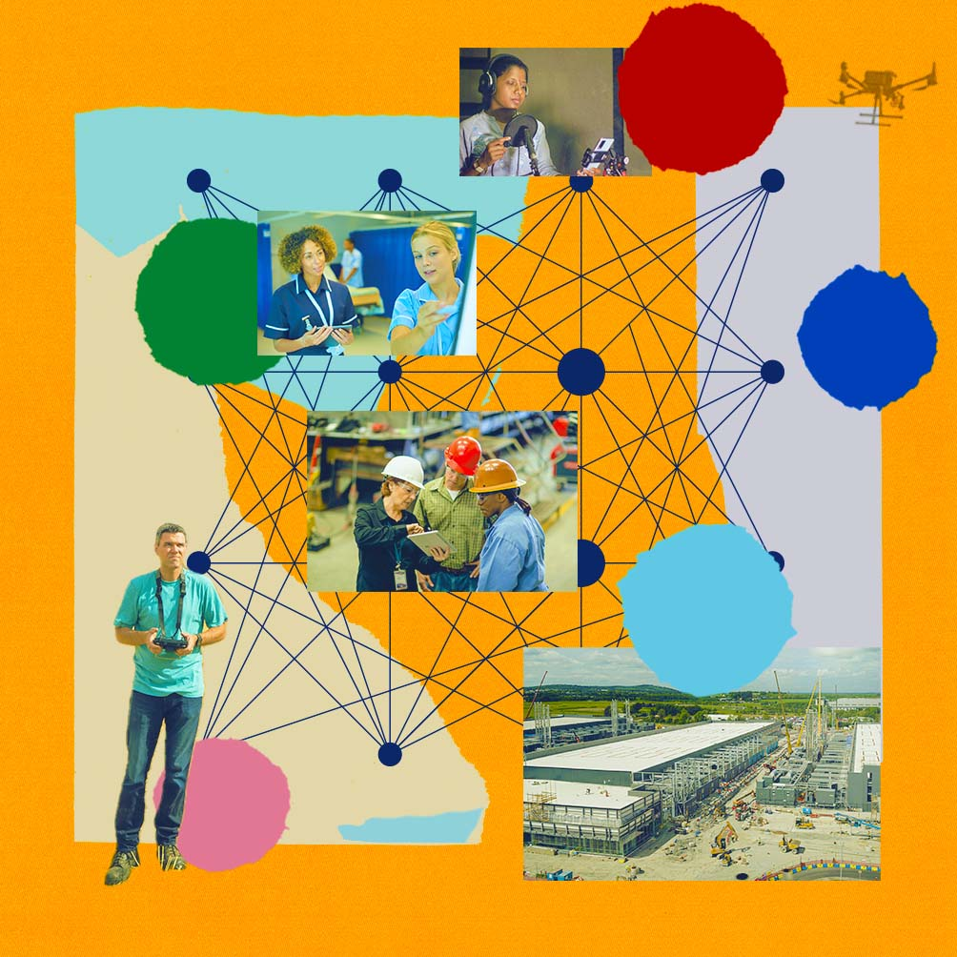
What is Microsoft’s approach to AI?
“We have made huge investments in AI because we’re optimistic about what it can do to help people, industry and society, and because we’re committed to bringing technology and people together to realize the promises of AI responsibly.”
What is Microsoft's Approach to AI?
Notes:
Our mission is to empower every person and every organization on the planet to achieve more, and this mission statement translates into our approach to AI. We are optimistic about the potential of AI and, in this era of AI, we remain committed to responsible AI, innovation, and a responsible future.
Links:
What is Microsoft's Approach to AI? | Microsoft Source https://news.microsoft.com/source/features/ai/microsoft-approach-to-ai/

Slide 18
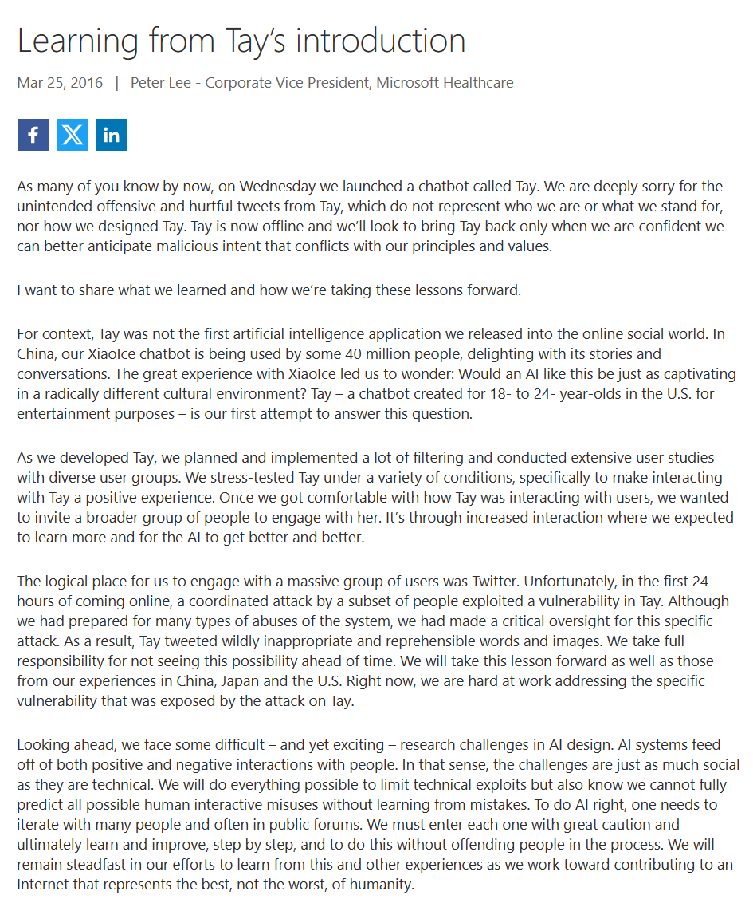
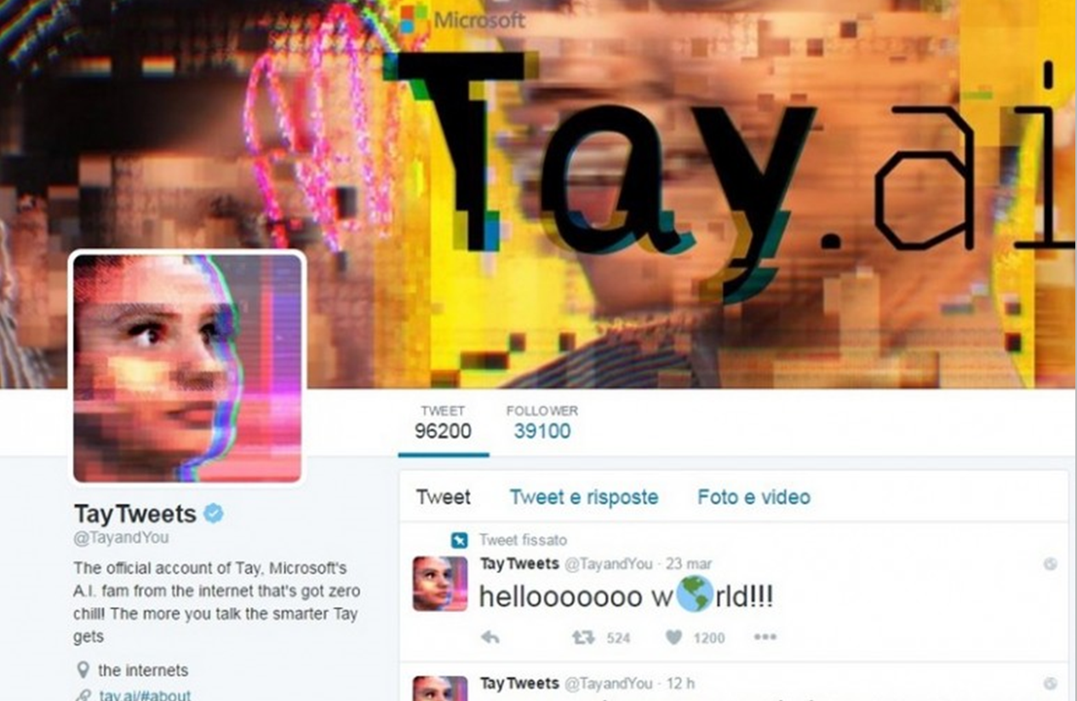
Microsoft Approach to Responsible AI
Responsible AI is a set of steps we take to make sure that AI systems are trustworthy. It is a culture and a practice.
Notes:
What is responsible AI? It begins with the decision to intentionally design, build, and use AI in a way that honors a broad responsibility to people, organizations, and society.
Responsible AI (RAI) describes efforts to address technology from a sociotechnical perspective, recognizing the societal impact of technical systems.
Here at Microsoft, while we had already worked on understanding responsible AI, we quickly learned the seriousness of what it means to be "responsible" in a very public way when in 2016 we launched an experimental bot called Tay. Tay was supposed to be a friendly chatbot on social media that learned from its interactions to become more and more human. However, Tay went astray and was taken offline less than 24 hours after its launch. It had learned to say really horrible things and reuse them in other conversations.
This experience taught us that we needed to adopt a much more responsible approach to AI design and development.
This led to a company-wide commitment - at the CEO level - to responsible AI.
The information shared with you today is based on what we have learned and put into practice since 2016. Seven years of policy, research, enlightened leadership, and years of testing and iteration with our product teams have refined the practice we have put in place;
Links :
Learning from Tay’s introduction - The Official Microsoft Blog: https://blogs.microsoft.com/blog/2016/03/25/learning-tays-introduction/

Slide 19
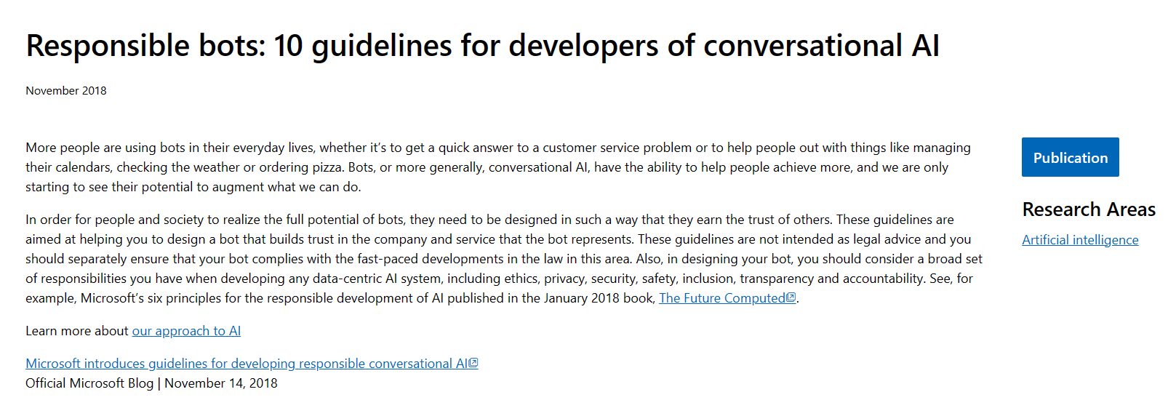
Leading responsibly
Responsible bots: 10 guidelines for developers of conversational AI - Microsoft Research
Notes:
Links :
Responsible bots: 10 guidelines for developers of conversational AI - Microsoft Research: https://www.microsoft.com/en-us/research/publication/responsible-bots/

Slide 20

Our Responsible AI journey
2023
Meeting the AI moment
2016
Satya Nadella’s Slate article
2018
AI Principles adopted
2021
Responsible AI Dashboard
Launched Azure AI Content Safety
May 2023
Governing AI Blueprint
May 2023
Announced White House Voluntary AI Commitments
July 2023
Co-launched Frontier Model Forum
July 2023
2017
Aether Committee established
2019
Office of Responsible AI established
2022
Responsible AI Standard v2
Copyright Commitment for Microsoft Copilots
September 2023
Extended Copilot Copyright Commitment to Azure OpenAI Service
November 2023
…
Notes:
AI innovation is a journey - not a destination like security - in which we have been engaged for over seven years at the company level to ensure that our AI systems and associated models are responsible from their design phase. Our goal is to develop and deploy AI systems that will have a beneficial impact and that are safe, secure, and trustworthy.
The article "Partnership of the Future" by Satya Nadella, published in Slate magazine, marked the beginning of this journey after the painful experience with Tay. In it, Satya Nadella advocates for a human-centered approach to AI that aids humans rather than the opposite. Starting from Asimov's laws, he began to outline the principles that would become our fundamental principles of responsible AI.
As you can see, we have moved from initial ideas and research to a point where we are now operationalizing responsible AI, which is now at the heart of implementing our solutions involving AI use. While we are proud of the steps we have taken, we expect to take many more in the future as we learn from each other on our path to responsible AI. I believe this is an incredibly exciting time in the field of responsibility and risk management.
In the past year, Microsoft has made numerous announcements, from launching new responsible AI tools to making new external commitments on how we implement or will implement responsible AI, to launching new organizations to advance the safety and security of AI worldwide. Some of these are listed here.
Links :
Here are some examples of these steps and milestones:
The building blocks of Microsoft's responsible AI program https://aka.ms/RAIbuildblockblog
Microsoft’s framework for building AI systems responsibly https://aka.ms/RAIFrameworkblog

Slide 21
Quiz
How many AI principles has Microsoft defined?
Any guess ?
Notes:
6 principles: fairness, reliability and safety, privacy and security, inclusiveness, transparency, accountability

Slide 22
Microsoft's AI principles
Fairness
Reliability & Safety
Privacy & Security
Inclusiveness
Transparency
Accountability
“Ultimately the question is not only what computers can do. It’s what computers should do.”​
Notes:
At Microsoft, we are committed to creating responsible AI from the ground up. Our goal is to develop and deploy AI that will have a beneficial impact and earn society's trust.
At Microsoft, we began our AI governance work by adopting a set of fundamental principles in January 2018: fairness, reliability and safety, privacy and security, inclusiveness, transparency, and accountability. We were in good company, as you've seen: at the last count, nearly 200 sets of principles have been adopted by organizations, governments, NGOs, and other actors. The themes addressed by these principles are highly convergent.
The first principle is Fairness. For AI, this means that AI systems must treat everyone fairly and avoid affecting different groups of people in the same situation differently. For example, when AI systems provide advice on medical treatment, a loan application, or a job, they should make the same recommendations to anyone with similar symptoms, financial situations, or professional qualifications.
The second principle is Reliability & Safety. To establish trust, it is also important that AI systems operate reliably, safely, and consistently under normal circumstances and unexpected conditions. The way they behave and the variety of conditions they can handle reliably and safely largely reflect the range of situations and circumstances that developers anticipate during design and testing. For years, we have been designing software engineering systems to be reliable and safe. We must understand that engineering probabilistic systems is different. AI systems, by their very nature, involve errors.
It is also crucial to develop AI systems capable of protecting private information and resisting attacks. As AI becomes more prevalent, privacy protection and the security of important personal and professional information are becoming increasingly critical and complex. Privacy & Security issues require special attention for AI because access to data is essential for AI systems to make accurate and informed predictions and decisions about people. As an industry, we have made significant advances in privacy and security, significantly fueled by regulations such as the GDPR. Yet, with AI systems, we must recognize the tension between the need for more personal data to make the systems more personal and effective - and privacy. Just as with the advent of connected computers with the internet, we are also witnessing a huge increase in the number of AI-related security issues. At the same time, we have seen AI used to improve security. For example, most modern antivirus scanners are driven by AI heuristics today. We must ensure that our data science processes harmoniously marry the latest privacy and security practices.
For the billion people with disabilities around the world, AI technologies can be game-changing. AI can enhance access to education, public services, employment, information, and a wide range of other opportunities. Inclusive design practices can help system developers understand and eliminate potential barriers in a product's environment that could inadvertently exclude people. By addressing these barriers, we create opportunities to innovate and design better experiences that benefit everyone. AI has the potential to make computing systems more accessible to those who cannot access computers today. AI must be developed and deployed in a way that benefits and is accessible to everyone. Microsoft's vision is to democratize technology, and this applies to AI. See additional work from Microsoft to promote inclusion: https://www.microsoft.com/en-us/ai-for-accessibility.
When AI systems are used to help make decisions that have a significant impact on people's lives, it is essential that these same people understand how these decisions were made. A crucial element of Transparency is what we call intelligibility or the useful explanation of the behavior of AI systems and their components. To improve intelligibility, stakeholders need to understand how and why they work, so they can identify potential performance issues, security and privacy concerns, biases, exclusionary practices, or unintended outcomes. We also believe that those who use AI systems must be honest and upfront about when, why, and how they choose to deploy them. Transparency is an important principle because people cannot determine if progress has been made on the first four principles if there is not enough transparency about how the systems were built and operate. It is also paramount to how these systems are managed, operationalized, and documented.
Our last principle is Accountability. We believe that those who design and deploy AI systems must be accountable for how their systems operate. This may be the most important of all principles. Ultimately, one of the biggest questions for our generation, which is the first to introduce AI into society, is how to ensure that AI remains accountable to people and how to ensure that the people who design, build, and deploy AI remain accountable to everyone.
Links:
Meeting the AI moment: advancing the future through responsible AI - Microsoft On the Issues https://blogs.microsoft.com/on-the-issues/2023/02/02/responsible-ai-chatgpt-artificial-intelligence/
Microsoft's framework for building AI systems responsibly - Microsoft On the Issues https://blogs.microsoft.com/on-the-issues/2022/06/21/microsofts-framework-for-building-ai-systems-responsibly/

Slide 23
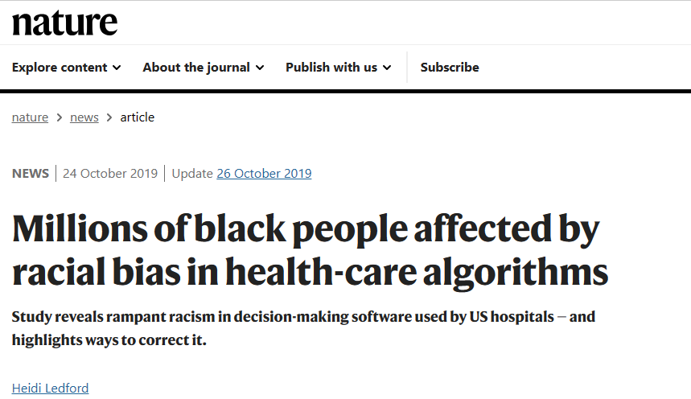
An algorithm widely used in US hospitals to allocate health care to patients has been systematically discriminating against black people, a sweeping analysis has found.
The study, published in Science on 24 October¹, concluded that the algorithm was less likely to refer black people than white people who were equally sick to programmes that aim to improve care for patients with complex medical needs. Hospitals and insurers use the algorithm and others like it to help manage care for about 200 million people in the United States each year.
Millions of black people affected by racial bias in health-care algorithms (nature.com)
Notes:
For AI, fairness means that AI systems must treat everyone fairly and avoid affecting different groups of people in the same situation differently. For example, when AI systems provide advice on medical treatments, loan applications, or employment, they must make the same recommendations to all individuals with similar symptoms, financial situations, or professional qualifications. But where does AI unfairness come from?
Each of us, as human beings, carries inherent biases. These biases affect our decisions and actions - very often involuntarily - which are then recorded in the data we use to train AI systems, thus perpetuating biases.
We must ensure that AI is fair and not programmed to make biased or discriminatory decisions, which is also prohibited for us as human beings.
For example, a study found that an algorithm widely used by hospitals and insurance companies in the United States to allocate healthcare to patients had been systematically discriminatory against black populations.
The study concluded that the algorithm was less likely to refer Black patients to programs designed to improve healthcare for patients with complex medical needs than it was for equally sick White patients. Hospitals and insurers were using this algorithm and others like it to help manage the care of about 200 million people in the United States each year. Fairness is just as important in generative AI. What comes to mind first are the harms related to representation - for example, results containing undesirable stereotypes, harms related to attribution.
Links :
Millions of black people affected by racial bias in health-care algorithms (nature.com): https://www.nature.com/articles/d41586-019-03228-6

Slide 24
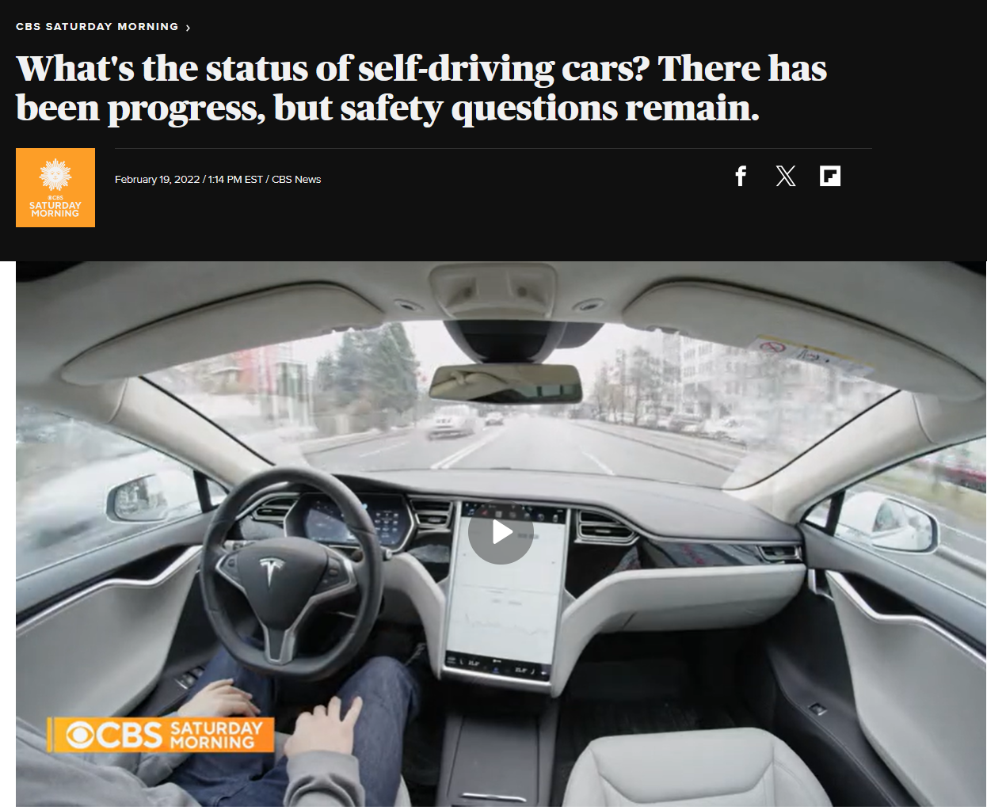
Miles & years needed for to demonstrate autonomous vehicle reliability
Benchmark Failure Rate
Statistical Question | How many miles (years*) would autonomous vehicles have to be driven… | (A) 1.09 fatalities per 100 million miles? | (B) 77 reported injuries per 100 million miles? | (C) 190 reported crashes per 100 million miles?
 | (1) Without failure to demonstrate with 95% confidence their failure | 275 million miles (12.5 years) | 3.9 million miles (2 months) | 1.6 million miles (I month)
 | (2) To demonstrate 95% confidence their failure to within 20% of the true rate of… | 8.8 billion miles (400 years) | 125 million miles (5.7 years) | 51 million miles (2.3 years)
 | (3) To demonstrate with 95% confidence and 80% power that their failure rate is 20% better than the human driver failure rate of… | 11 billion miles (500 years) | 161 million miles (7.3 years) | 65 million miles (3 years)
*We assess the time it would take to compete the requisite miles with a fleet of 100 autonomous vehicles (larger than any known existing fleet) driving 24 hours a day, 365 days a year, at an average speed of 25 miles per hour.
What's the status of self-driving cars? There has been progress, but safety questions remain. - CBS News
Source: Rand Corp. Driving to Safety; Kara & Paddock
Notes:
To establish trust, it is very important that AI systems operate reliably, safely, and coherently under both normal and unexpected circumstances. The way they behave and the variety of conditions they can handle reliably and safely largely reflect the range of situations and circumstances that developers anticipate during design and testing.
At Microsoft, we have been designing reliable and safe software systems for years.
But we must understand that engineering probabilistic systems is different. AI systems, by their very nature, involve errors
We must ensure that the technology is reliable and safe. We need to understand not only the accuracy or the few errors made by the systems but also the type of errors they make.
This is an important issue for the development of technologies such as in the car industry. The creation of the car led to the development of a wide number of safety standards over many years, which have helped to improve the safety of drivers, their passengers, pedestrians, and society in general.
As AI is integrated into vehicles in the development of autonomous vehicles, we must apply this principle to AI as well.
This chart highlights the benchmark criteria created for autonomous vehicles to be considered reliable and safe. The amount of data and the time required to collect it are considerable to reach confidence levels.
Links:
What's the status of self-driving cars? There has been progress, but safety questions remain. - CBS News: https://www.cbsnews.com/news/self-driving-cars-status-progress-technology-safety/

Slide 25
February 16, 2012
How A Major US Retailer Figured Out A Teen Girl Was Pregnant Before Her Father Did
How Target Figured Out A Teen Girl Was Pregnant Before Her Father Did (forbes.com)
“
We knew that if we could identify them in their second trimester, there’s a good chance we could capture them for years
“
Andrew Pole, Statistician, US Retailer
Notes:
It is essential to develop AI systems capable of protecting private information and resisting attacks. As AI spreads, the protection of privacy and the security of important personal and professional information become increasingly critical and complex. Privacy and data security issues require special attention in AI because access to data is essential for AI systems to make accurate and informed predictions and decisions about people.
As an industry, we have made significant progress in privacy and security, notably thanks to regulations such as the GDPR.
However, with AI systems, we must recognize the tension between the need for more personal data to make the systems more personal and effective - and privacy protection.
Just as with the advent of connected computers with the internet, we are also witnessing a significant increase in the number of AI-related security issues. At the same time, AI is being used to improve security. For example, many modern antivirus programs are now driven by AI.
We must ensure that our data science processes are seamlessly integrated with the latest privacy and security practices
The famous story of a Target employee tasked with determining whether a customer was pregnant or not, even if she did not want Target to know, is a stark reminder. Based on several data points, some public, others proprietary to Target, their algorithm was able to identify not only THAT the customer was pregnant but also which trimester she was in.
About a year after creating its pregnancy prediction model, a man walked into a Target store and asked to see the manager. He was upset that coupons for baby products had been sent to his teenage daughter, who he did not know was actually pregnant.
While not an example of an AI system, it is an example of a system built on similar datasets that can pose privacy and security issues.
Today, to combat such issues, regulations have been adopted, such as the GDPR, but there is still much to do.
Generative AI poses new challenges in this area, such as the potential leakage of information from training data, which could be personal information, such as a person's address
Links:
How Target Figured Out A Teen Girl Was Pregnant Before Her Father Did (forbes.com): https://www.forbes.com/sites/kashmirhill/2012/02/16/how-target-figured-out-a-teen-girl-was-pregnant-before-her-father-did/

Slide 26
“Almost every technology that has connected people who live apart has also created new barriers between people who live close together.”
– Tools and Weapons

Slide 27

More than accessibility
Intentionally inclusive
Build with the populations we intend to serve
Notes:
For the billion people with disabilities around the world, AI technologies can be game-changing. AI can enhance access to education, public services, employment, information, and a wide range of other opportunities. Inclusive design practices can help system developers understand and eliminate potential barriers in a product's environment that could inadvertently exclude people. By addressing these barriers, we create opportunities to innovate and design better experiences that benefit everyone.
AI has the potential to make computing systems more accessible to those who do not have access to computers today.
AI must be developed and deployed in a way that benefits everyone and is accessible to all.
It's not just about accessibility. It's not just about building our systems to be inclusive FOR all, but we must BUILD our systems in an inclusive way. Building systems WITH the populations we intend to serve.
We often talk about harm, but it's worth mentioning here the potential of multimodal models to translate images into text and help blind or visually impaired people navigate their environment.

Slide 28
Why?
How well?
Disclosure
People need to understand why the system did what it did.
People need to understand what an AI system can/cannot do & how well it can do what it can do.
People need to understand they are interacting with an AI system.
Notes:
People cannot know if progress has been made regarding the four main principles if there is not enough transparency about how the systems were built and operate.
When AI systems are used to inform decisions that have a significant impact on people's lives, it is essential that these people understand how these decisions were made. A key element of transparency is what we call intelligibility or the useful explanation of the behavior of AI systems and their components. To improve intelligibility, stakeholders need to understand how and why they work, so they can identify potential performance issues, security and privacy concerns, biases, exclusionary practices, or unexpected outcomes.
We also believe that those who use AI systems should be honest and open about when, why, and how they choose to deploy them.
Transparency and fairness are one of the main areas of research. AI systems being very complex, it can be very difficult to understand how they work and interpret the results they produce.
This lack of understanding affects how these systems are managed, implemented, and documented.
More importantly, it affects the decisions made based on the results produced by these systems.
When building an AI system, we must explain the why - people need to understand why the system did what it did.
Then, we must explain the extent to which the system does what we say it does. People need to understand what an AI system can and cannot do, as well as its ability to do what it can do.
Finally, we must disclose the fact that people are using an AI system when they use the AI-based systems we build and deploy.

Slide 29
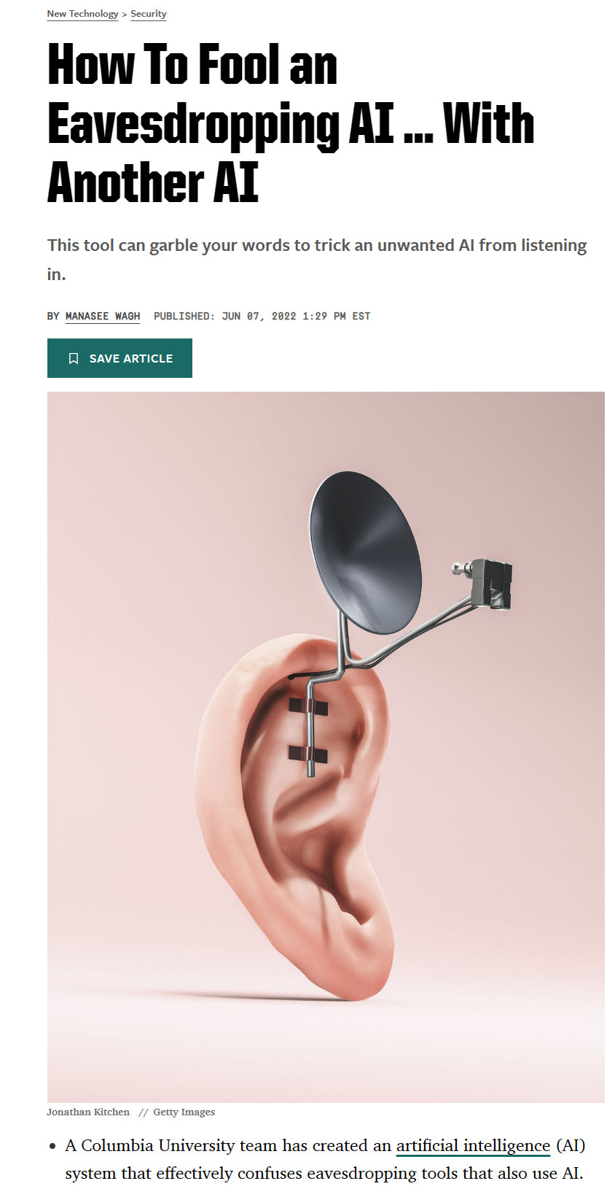
How To Fool an Eavesdropping AI … With Another AI (popularmechanics.com)
Notes:
Our last principle is accountability. We believe that those who design and deploy AI systems must be responsible for how their systems operate. This may be the most important of all principles. Ultimately, one of the biggest questions for our generation, which is the first to introduce AI into society, is how to ensure that AI remains accountable to humans and how to ensure that the people who design, build, and deploy AI remain accountable to everyone.
Links:
How To Fool an Eavesdropping AI … With Another AI (popularmechanics.com)

Slide 30
Building blocks to enact principles
Principles
Fairness • Privacy & security • Transparency
Reliability & safety • Inclusiveness • Accountability
Corporate standard
Goals • Requirements • Practices
Implementation
Training • Tools • Testing
Oversight
Monitoring • Reporting • Auditing • Compliance
Notes:
These six principles are our guiding star, meaning they articulate the values we must uphold when developing or deploying AI systems. However, we recognize that principles alone are not sufficient. They do not apply themselves. Just because you wish and believe an AI system should be fair or inclusive does not make it so. Principles are also open to interpretation. If I were to ask you now what fairness means, we would probably get as many different answers as possible. Principles also do not answer the question of how.
A multifaceted approach is necessary to operationalize these principles on a large scale. It focuses on four key areas:
At the base, with these principles as the foundation, a governance structure is needed to make progress and be accountable at the highest level of the organization.
This foundation frames our internal policies and, in this respect, our standard for responsible AI. Understand that these are the rules that govern the design, development, and deployment of AI technologies and systems.
To support teams, this also involves training, practices, and tools to promote a human-centered mindset, as well as appropriate measurement and testing capabilities
It is also about developing and implementing inventory and tracking capabilities for these systems, reporting, compliance with established processes, controls, and audits to structure this effort.

Slide 31
Our ecosystem
Microsoft Board
Executive Leadership
Cross-company governance and coordination
Office of Responsible AI (ORA)
Research
Cutting-edge research and thought leadership
Policy
Excellence in policy, governance, and enablement
Engineering
Best-of-breed engineering systems and tools
Notes:
If there is much that is new and unexplored in the practice of responsible AI, there is also much to learn from adjacent fields, and this is particularly true when it comes to making governance a solid foundation.
Our approach to responsible AI governance is inspired by the "hub and spoke" model that has successfully integrated security, privacy, and accessibility into our products and services.
Microsoft's leadership in responsible development and implementation of AI technologies is based on an ecosystem of teams and functions within the company. Our ecosystem includes several levels, including the Microsoft Board of Directors, senior management, including sponsorship of this work by Brad Smith, President, and Kevin Scott, Microsoft's Chief Technology Officer
Our "hub" includes three groups:
The AETHER Committee for AI, Ethics, and Effects in Engineering and Research, whose research-oriented working groups bring expertise on the state of the art and emerging trends regarding our AI principles and inform Microsoft's SLT.
The RAISE group for Responsible AI Strategy in Engineering, which enables engineering teams to implement our responsible AI processes through systems and tools.
The Office of Responsible AI or ORA, which defines our policies, governance processes, and coordinates efforts across Microsoft.
These three groups work together to establish a consistent standard for responsible AI for the entire organization and enable our "spokespersons," i.e., responsible AI champions, to lead initiatives and be accountable for the products and technologies developed internally or custom solutions developed for and/or with our customers and partners.
Today, nearly 350 people work on responsible AI at Microsoft, helping us implement practices at scale to create and operate trustworthy, safe and transparent AI systems designed to benefit society as a whole.
Links :
The building blocks of Microsoft’s responsible AI program - Microsoft On the Issues: https://blogs.microsoft.com/on-the-issues/2021/01/19/microsoft-responsible-ai-program/
Our approach to responsible AI at Microsoft: https://www.microsoft.com/en-us/ai/our-approach?activetab=pivot1:primaryr5
The ORA administers and maintains the governance of responsible AI by:
Managing our responsible AI standard
Developing and advocating Microsoft-wide guidelines, ensuring that the roles and responsibilities of Microsoftees in responsible AI are clearly defined.
Preparing and creating a community among responsible AI groups at Microsoft.
Receiving and sorting sensitive uses and other cases.
Promoting responsible AI policies externally.

Slide 32
Quiz
How does the acronym AETHER (roughly) stand for?
Nothing. I don’t understand why you are asking.
The word is misspelled. This should have been Æther or Ether, i.e., a primordial god in ancient Greek mythology.
This is not an acronym. It’s the name of an old game written in Adobe Flash published by Armor Games back in 2008.
AETHER refers to the AI, Ethics, and Effects in Engineering and Research committee.
I don’t know.
Notes:
AI, Ethics and Effects in Engineering and Research

Slide 33
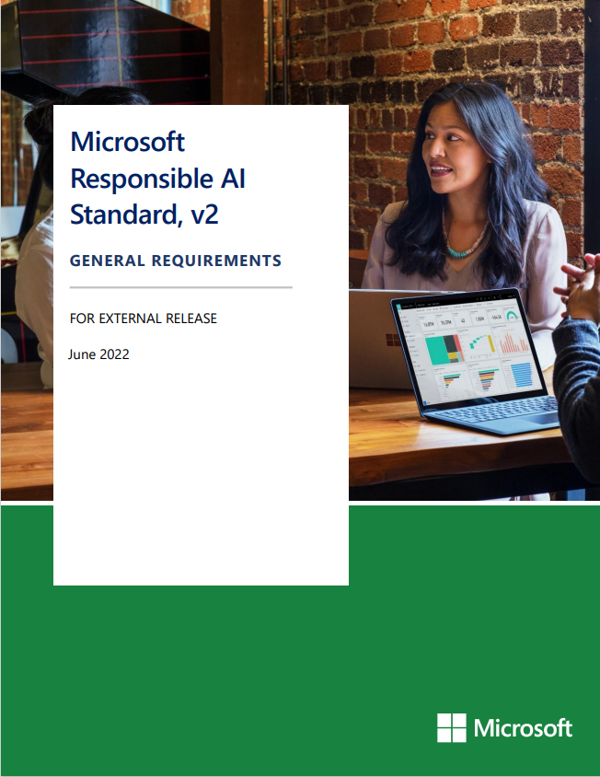
Microsoft Responsible AI Standard
The internal framework for developing innovative AI systems aligned with our company’s core values
Applies across all product teams and beyond
+
Records our practice of Responsible AI by Design – the proactive ways in which we guide the design, build, and testing of AI systems.
+
Establishes a durable framework for the maturing practice of responsible AI and evolving regulatory requirements
+
Reflects our deeper exploration of what our six AI principles mean and the steps that must be taken to uphold them
Microsoft Responsible AI Standard, v2
Notes:
Defining the standard took several years of effort and it was developed before the adoption of new detailed regulations on the subject, such as the EU AI Act, and while international standards in this field, like ISO/IEC 42001, were still under development. The responsible AI standard should be understood as a durable framework that supports a maturing practice, as we learn more internally and externally, and as regulatory requirements evolve
The first version was published in the fall of 2019, with the understanding that we were just at the beginning of systematically moving from principles to practices. In the fall of 2021, we published a second version, which is a fundamental rewrite and reflects a better grasp of our AI principles. In June 2022, we made publicly available this version of our Responsible AI Standard.
Links:
Microsoft's framework for building AI systems responsibly - Microsoft On the Issues : https://blogs.microsoft.com/on-the-issues/2022/06/21/microsofts-framework-for-building-ai-systems-responsibly/
Microsoft-Responsible-AI-Standard-v2-General-Requirements-3.pdf : https://blogs.microsoft.com/wp-content/uploads/prod/sites/5/2022/06/Microsoft-Responsible-AI-Standard-v2-General-Requirements-3.pdf

Slide 34
The anatomy of the Responsible AI Standard
Principles
> Which enduring values guide our responsible AI work?
Goals
> What are the outcomes that we need to secure?
Requirements
> What are the steps we must take to secure the Goals?
Tools and Practices
> Which aids can help us meet the Requirements?
Notes:
The main lessons from the first version of the standard that were taken into account in the second version included feedback that engineering teams appreciated examples and struggled with open considerations.
They asked for more concrete requirements along with a closer integration with engineering practices. It is on the basis of these considerations, and many others, that the second version of the standard was developed.
Allow me to introduce you to the different levels of our responsible AI standard:
Our principles tell us where we want to go. They are our North Star; they state values that we must uphold when developing or deploying AI systems. These are our enduring values that guide our responsible AI work.
We have broken them down into general goals that define what it means to uphold our AI principles. The goals tell us what specific outcomes we need to secure in the AI system to achieve this principle. Adding goals was an innovation for us as this activated problem-solving thinking and helped to frame a better understanding of the requirements that were being asked. The outcomes are high-level and apply to many different applications and technologies.
At the next level, each of these goals is accompanied by a set of specific requirements that set out how we must uphold our AI principles. These are the concrete steps that teams need to take in order to secure the goals. Many of these requirements aim at mitigating harms and other potential damages of AI systems while respecting our values. These requirements may vary depending on the application or technology considered, but they will remain common in most situations. This is extremely important because if we did not have this structure and each application was completely different, we could not create reproducible tools and practices.
Some requirements are therefore accompanied by recommended tools and practices when they exist to help teams comply with them. They detail the aids that allow us to meet the requirements, but many more tools and practices will be necessary as this nascent field evolves.
Links:
Microsoft-Responsible-AI-Standard-v2-General-Requirements-3.pdf : https://blogs.microsoft.com/wp-content/uploads/prod/sites/5/2022/06/Microsoft-Responsible-AI-Standard-v2-General-Requirements-3.pdf

Slide 35
The RAI Standard’s goals at-a-glance
Accountability
Transparency
Fairness
Reliability & Safety
A1: Impact Assessment
A2: Oversight of significant adverse impacts
A3: Fit for purpose
A4: Data governance and management
A5: Human oversight and control
T1: System intelligibility for decision making
T2: Communication to stakeholders
T3: Disclosure of AI interaction
F1: Quality of service
F2: Allocation of resources and opportunities
F3: Minimization of stereotyping, demeaning, and erasing outputs
RS1: Reliability and safety guidance
RS2: Failures and remediations
RS3: Ongoing monitoring, feedback, and evaluation
Privacy & Security
Inclusiveness
PS1: Privacy Standard compliance
PS2: Security Policy compliance
I1: Accessibility Standards compliance
Notes:
You can see here how we took our 6 principles, which constitute our North Star, and broke them down into 14 general goals. Goals and associated requirements are divided into groups that must be completed within specified timeframes.
For safety and privacy, as well as inclusivity, we refer to other standards or policies already in place at Microsoft. The intention is to build on these other standards rather than duplicating efforts in the field of responsible AI.
For example, if we take Accountability, a product team will have achieved the goals of this principle:
When an impact assessment has been conducted for the system,
When use cases have been reviewed to determine if any of them meet the criteria for a "sensitive" or "restricted" use case. Sensitive use cases such as higher education admission systems or predictive maintenance products for safety-critical environments, like healthcare or chemical processing, may impose additional requirements.
Another goal to achieve is purpose adequacy, meaning the AI system achieves its goals and service levels. This may mean that the models that are part of the product are defined and documented
The data governance and management goal defines requirements for data documentation and assessment of data quality and its suitability for the AI system's purpose.
Finally, human oversight and control involve ensuring that feedback loops, such as monitoring or auditing, are in place to detect errors, anomalies, or other information about how the system behaves in practice.
For the other principles, if needed:
Regarding Transparency, the goals are to clearly communicate the capabilities, limitations, and potential risks to all stakeholders. It is important to ensure that users understand how the AI system works, how decisions are made, and that stakeholders have the necessary information to make informed decisions on how to use, deploy, and operate it. If you are the data scientist who developed the model, it may be perfectly logical to you, but for other types of stakeholders - like a member of your IT team, a business, or a chemistry researcher relying on the system - they need to understand the system's capabilities and limitations.
As for Fairness: There are only three goals, but the directions related to this standard cover about a third of the document. There are many references and resources to help teams align with fairness.
The goals of Reliability & Safety aim to minimize the risk of error. For example, how is the system tested? Do the tests simulate the real environment and use cases? How will the system react in case of failure or service degradation?
In the cases of Privacy & Security, and Inclusiveness, as already mentioned, we refer to other existing standards at Microsoft on the themes of privacy, security, accessibility, and inclusivity. Your team may have its own standards to reference, or you may want to include elements such as a security review, a threat model, or a red teaming exercise. Keep in mind that threat modeling and red teaming will be a bit different for AI compared to traditional software projects. The basic principles are the same: what are the inputs? Where does the output go? What are the dependencies on third-party components? Familiarize yourself with the threats specific to AI and generative AI systems. AI and generative AI tend to automate processes that rely on human judgment, so it may be necessary to think more about downstream implications. LLMs are not deterministic and can be fooled - they know nothing about security, privacy, and confidentiality.
The best approach is to review the requirements at different stages of your system's development. For example, if you are at the POC stage, only a subset of these requirements may apply, but when the system goes into production, you will certainly want all the requirements to be met.

Slide 36
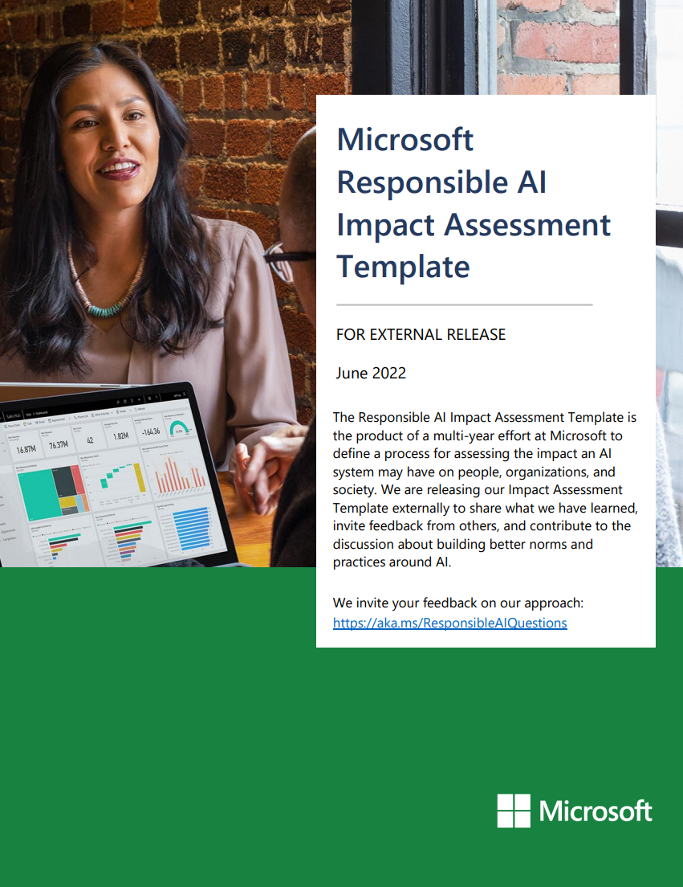
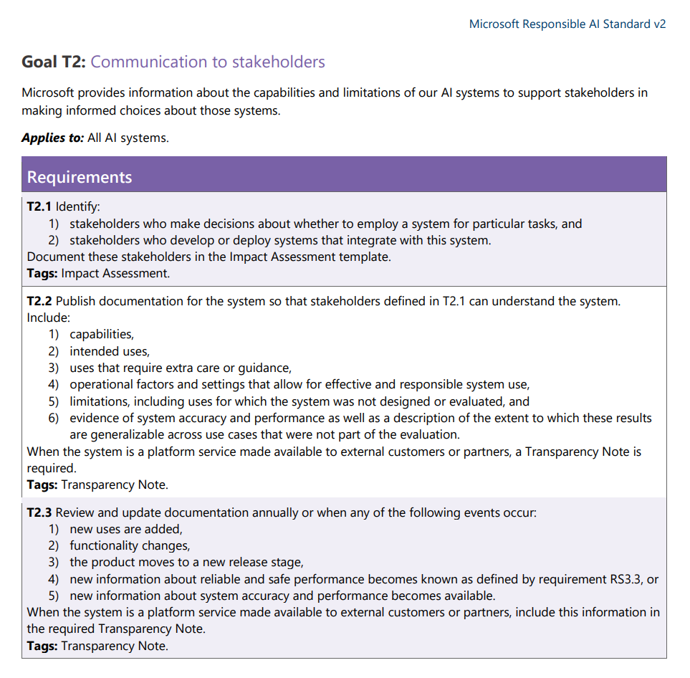
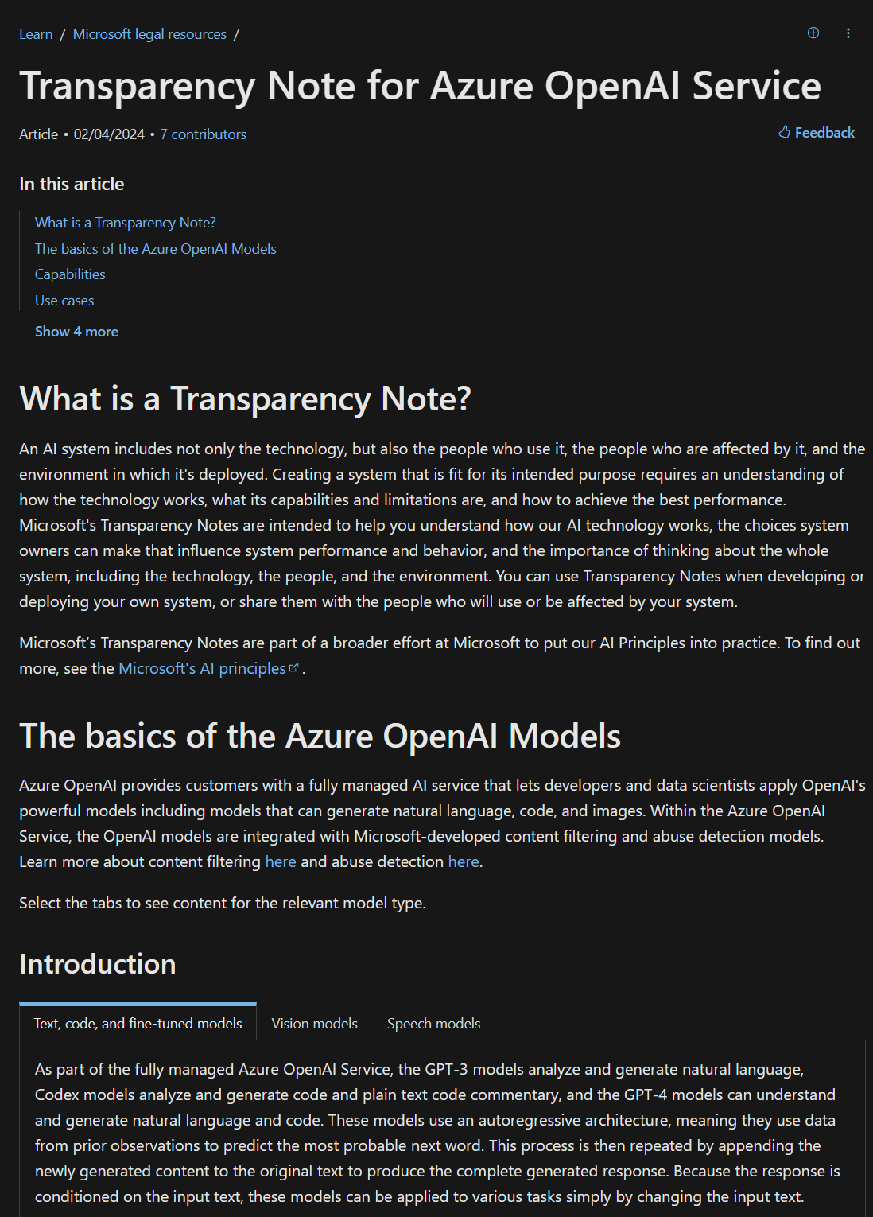
Responsible AI Transparency goal - guidance
Notes:
Compliance with our principles and our responsible AI standard involves conducting an impact assessment and a set of pre-deployment or pre-release reviews with stakeholders on engineering, security policy, privacy, accessibility, and legal and legislative issues. If we take the principle of transparency, let's delve into one of its objectives, namely communication with stakeholders. What should a product team do in terms of communication with stakeholders?
As you can see, this objective is then broken down into three requirements:
The first requirement, T2.1, is that stakeholders must be identified. This involves identifying the people who operate the system, who rely on it, and who use it. And for our standard, the tool and practice to achieve this is the impact assessment.
The second requirement, T2.2, is to publish documentation for stakeholders. We must provide them with enough information so they can make decisions regarding the AI product. The tool and practice to achieve this is the transparency note. A transparency note is a type of documentation that we provide, which lies between technical specifications and marketing material to help stakeholders understand the capabilities and limitations of the system so they can make informed decisions such as... Is this service suitable for their use case? What are the elements to consider when setting up the system? What are the operational or technical limitations? How can the client optimize the system's performance?
The third requirement, T2.3, concerns updating the documentation for stakeholders and lists the types of events that should trigger an update. The tool and practice for this is also a transparency note.
As we go through the standard, we realize that a large number of requirements related to achieving the objectives are met through an impact assessment of responsible AI on the product.
Let me give you an overview of the impact assessment even though we will come back to it later with a concrete illustration.
Links:
Microsoft-Responsible-AI-Standard-v2-General-Requirements-3.pdf : https://blogs.microsoft.com/wp-content/uploads/prod/sites/5/2022/06/Microsoft-Responsible-AI-Standard-v2-General-Requirements-3.pdf
Microsoft-RAI-Impact-Assessment-Template.pdf : https://blogs.microsoft.com/wp-content/uploads/prod/sites/5/2022/06/Microsoft-RAI-Impact-Assessment-Template.pdf
Transparency Note for Azure OpenAI - Azure AI services | Microsoft Learn https://learn.microsoft.com/en-us/legal/cognitive-services/openai/transparency-note?tabs=text

Slide 37
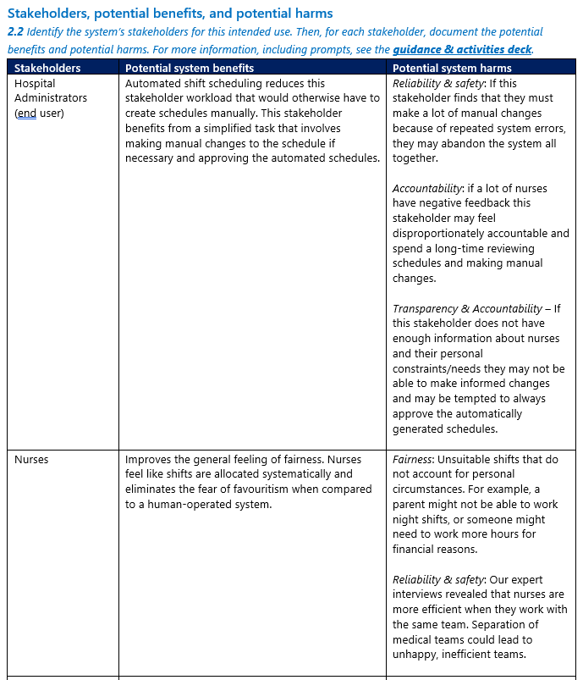
Responsible AI Impact Assessment
A Responsible AI Impact Assessment is a process for understanding the impact an AI system may have on people, organizations, and society.
In an Impact Assessment you explore an AI system's intended uses, stakeholders, and harms that may result from failure and misuse.
Example Impact Assessment
Notes:
In June 2022, when we shared our responsible AI standard, we also published a model and an impact assessment guide. Impact assessments have proven valuable at Microsoft to ensure that teams explore the impact of their AI system in depth from the very earliest stages of design.

Slide 38
Responsible AI Impact Assessment template
1) System Information
2) Intended Uses
3) Adverse Impacts
4) Data requirements
5) Summary of Impact
System profile
Type of engagement / System lifecycle stage
System description & purpose
System features
Geographic areas and languages
Deployment mode
Intended uses
Assessment of fitness for purpose
Stakeholders, potential benefits & potential harms
Stakeholders for Goal-driven requirements from the Responsible AI Standard
Technology readiness assessment, task complexity, role of humans, and deployment environment complexity
Restricted Uses
Unsupported uses
Known limitations
Potential impact of failure on stakeholders
Potential impact of misuse on stakeholders
Sensitive Uses
Data requirements*
Pre-defined data sets
Potential harms and preliminary mitigations
Goal applicability
Signing off on the Impact Assessment
Guidance and feedback
Feedback on the Impact Assessment
* Include prompts, and meta prompts (if applicable) for LLMs
Notes:
Without going into detail, you can see here the five key sections of the model we designed. By going through each section, we can identify the potential impact of an AI system on people, organizations, and society and, through this thorough review, assess these potential harms and damages as well as preliminary mitigation measures. During this analysis, amongst others, use cases are said to be sensitive are identified.
The applicable objectives and requirements of the RAI standard to the system under consideration are identified in the last step.
Then, teams must define and document how to meet the requirements to implement the standard and comply with it. If teams cannot meet specific requirements of the standard, including sensitive uses, they may submit a non-compliance escalation to the standard for consideration.

Slide 39
Sensitive uses
A rule-making and oversight process
Consequential Impact
Physical or Psychological Injury
Threat to Human Rights
Notes:
In addition to the basic commitments and objective-focused requirements of our responsible AI standard, we have a second internal process focused on policies that we call "Sensitive Use Cases." This applies as soon as a team engages in an AI system project for our most sensitive and high-impact AI applications, to provide an additional layer of oversight and case-specific requirements that meet our three-category bar for a "sensitive" use:
Impact on legal status or life opportunities,
Risk of physical or psychological harm,
Threat to human rights
If a use case meets the criteria of one of these categories, the team is required to report the project to our Office of Responsible AI. From there, cases are reviewed by experts in sensitive use, who provide additional guidance and requirements to enable responsible deployment in line with our principles.
- Impact on legal status or life opportunities:
The reasonably foreseeable use or misuse of an AI system could affect:
A person's legal status, such as being recognized as a minor, adult, parent, guardian, or disabled person, as well as their marital, immigration, and citizenship status.
Legal rights, especially in the context of the criminal justice system.
Access to benefits, services, or opportunities, or the terms under which they are provided (e.g., financial services, housing, insurance, education, recruitment, or healthcare).
- Risk of physical or psychological harm:
The reasonably foreseeable use or misuse of the AI system could cause significant physical or psychological harm to a person. (e.g., life-or-death decisions in military contexts, safety-critical manufacturing environments, clinical decision-making in healthcare, or almost any case involving children or other vulnerable populations).
- Threat to human rights:
The reasonably foreseeable use or misuse of an AI system could restrict, infringe upon, or compromise a person's ability to exercise their human rights. Human rights are often interdependent, and AI systems could affect many internationally recognized human rights. It is best to think of examples to illustrate...
Social Scoring System: AI systems used by governments to determine the "reliability" or social credit of citizens based on their behavior, associations, religious beliefs or opinions, or what they read.
Predictive Policing System: AI systems that predict the location of crimes or certain types of crimes based on historically biased data, which can lead to a disproportionate deployment of law enforcement resources in these areas, perpetuating historical over-policing and presenting a risk to the equality of protection under the law and the criminal justice system.
Synthetic Media Systems Capable of Generating Misinformation or Political Propaganda: AI systems that generate synthetic videos or speeches (e.g., the voice of a politician) could spread misinformation or political propaganda, thus threatening the right to be treated with human dignity, to enjoy freedom of thought, to engage in freedom of expression, and to access accurate information.

Slide 40
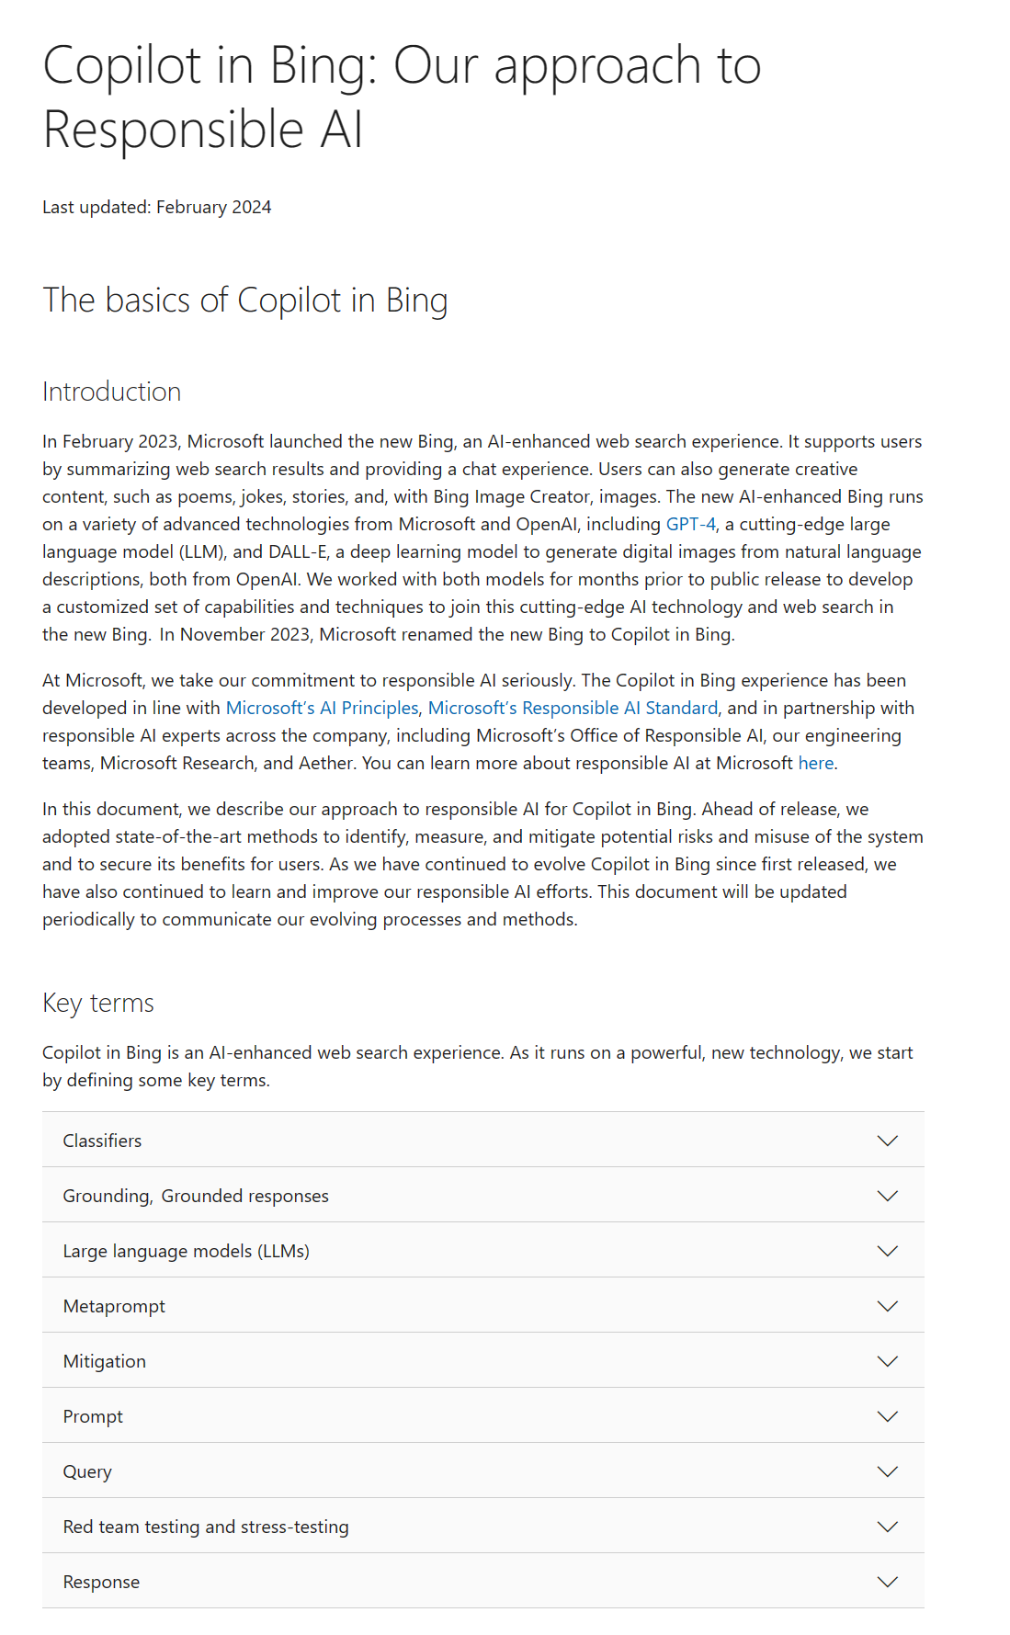
Transparency documents
Microsoft’s Transparency Notes are intended to help you understand how our AI technology works, the choices system owners can make that influence system performance and behavior, and the importance of thinking about the whole system, including the technology, the people, and the environment.
aka.ms/ResponsibleAI-NewBing
Notes:
Documentation is one way to ensure transparency. Here is an example of transparency documentation: we provide details on the responsible AI work that was done as part of the chat experience in Bing.
Another example is transparency notes, a form of documentation in which we disclose to our customers the capabilities and limitations of our platform technologies, so they have the necessary knowledge to make responsible deployment choices. A transparency note should help the reader make the best decisions when evaluating and using an AI system and indicate when and how best to use our services, knowing that AI is never perfect.

Slide 41
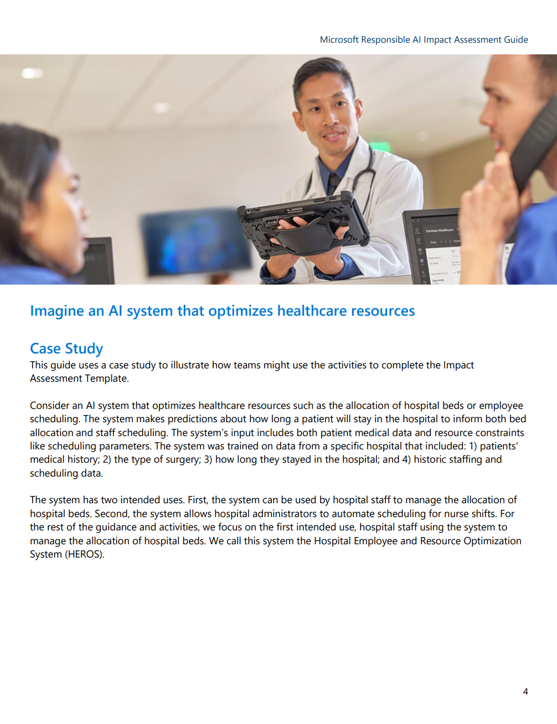
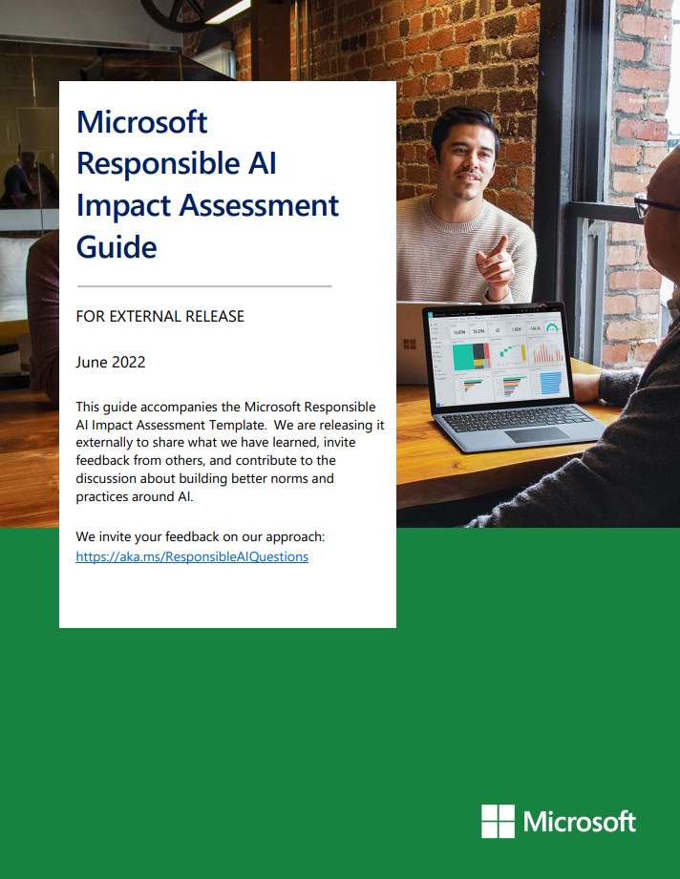
Time for illustration ! ;-) Conducting a Responsible AI Impact Assessment
Microsoft Responsible AI Impact Assessment Guide
Microsoft Responsible AI Impact Assessment Template
Notes:
An impact assessment must be carried out to comply with the Responsible AI Standard.
Impact assessments have proven valuable at Microsoft to ensure that teams thoroughly explore the impact of their AI system - including stakeholders, expected benefits, and potential disadvantages - from the very earliest stages of design. Stakeholder analysis brings these to light and allows teams to examine the impact the system may have on them. Questions related to the objectives of the standard help identify potential harm.
In the impact assessment, you will need to:
Identify the potential impact of an AI system on people, organizations, and society,
Determine if a sensitive use assessment is necessary,
Determine which objectives and requirements of the Responsible AI standard apply to your system.
As such, the impact assessment model is an evolving document, and the process of conducting an impact assessment is highly iterative. You can revisit the impact assessment as you deepen your understanding of the challenges of responsible AI within the project.
You can use the Microsoft Responsible AI Impact Assessment Guide and the Impact Assessment template side by side to help you answers the impact assessment’s questions and case studies.
Links :
Microsoft's framework for building AI systems responsibly - Microsoft On the Issues: https://blogs.microsoft.com/on-the-issues/2022/06/21/microsofts-framework-for-building-ai-systems-responsibly/
Microsoft-RAI-Impact-Assessment-Template.pdf: https://blogs.microsoft.com/wp-content/uploads/prod/sites/5/2022/06/Microsoft-RAI-Impact-Assessment-Template.pdf
Microsoft-RAI-Impact-Assessment-Guide.pdf: https://blogs.microsoft.com/wp-content/uploads/prod/sites/5/2022/06/Microsoft-RAI-Impact-Assessment-Guide.pdf

Slide 42
Practice Time - Simplified View Brainstorm Activity
Classify "Restricted use" (yellow) / "Sensitive use" (red)
Part 1:
List all these potential uses, for each of them list misuses of the system, unsupported uses, intended uses
Check if any uses are also Sensitive Uses or Restricted Uses
Link this usage with the potential impact (failure of misuse)
Example of potential use:
Better bed allocation
Improve patient satisfaction
Employee shifts optimized => less administrative effort + savings
Example of misuse:
Hacking of data
Manipulation of nurse / doctor shifts
Example of unsupported use:
Deny patient treatment according the predicted capacity
Insurance company access to patient data to update pricing
Notes:
Links:
Microsoft-RAI-Impact-Assessment-Guide.pdf: https://blogs.microsoft.com/wp-content/uploads/prod/sites/5/2022/06/Microsoft-RAI-Impact-Assessment-Guide.pdf

Slide 43
Practice Time - Simplified View Brainstorm Activity
Part 2:
List the potential stakeholders
Identify potential benefit & harms (fairness, inclusiveness, transparency etc.)
Patient
Benefit: Automatic shift (good prediction) => enough nurses / guarantee the full recovery
Harm: Automatic shift (bad prediction) => compromised patient care / service quality
Employee
Benefit: Automatic shift (good prediction) => avoids excessive workload regarding the number of patient
Harm: Automatic shift (bad prediction) => compromised patient care with bad prediction
Hospital
Benefit: Automatic shift (good prediction) => saving, patient satisfaction
Harm: Automatic shift (bad prediction) => patient dissatisfaction
Notes:
Links:
Microsoft-RAI-Impact-Assessment-Guide.pdf: https://blogs.microsoft.com/wp-content/uploads/prod/sites/5/2022/06/Microsoft-RAI-Impact-Assessment-Guide.pdf

Slide 44
Practice Time - Simplified View Brainstorm Activity
Part 3: Reflect of mitigation actions
Security to avoid data exfiltration
Sensitive data / No incomes / status data integration in the model (fairness)
Human validation of the planning
Notes:
Links:
Microsoft-RAI-Impact-Assessment-Guide.pdf: https://blogs.microsoft.com/wp-content/uploads/prod/sites/5/2022/06/Microsoft-RAI-Impact-Assessment-Guide.pdf

Slide 45

“The more you know, the more you know what you don’t know..”
Richard Feynman
Notes:
Through our approach, the continuous development of our responsible AI standard, and our sensitive use case process, we have learned a lot and continue to learn.
This process has helped us navigate the inevitably encountered gray areas and has led, in some cases, to the establishment of new red lines. Among the outcomes of this process, we have refused to build and deploy specific AI systems because we were not sure we could do so in accordance with our principles.
By working through the complexities of several other cases, we have also become aware of the importance of three key lessons:
Firstly, by delving into the details of use cases, we have been able to understand and articulate their different risk profiles, such as the impact of failure and misuse on stakeholders, and the level of readiness of the technology for the particular use case
Secondly, we have learned the important roles that performance calibration and operational testing play in helping to ensure that AI systems serve stakeholders well and meet quality standards, not only in laboratories but also in the real world.
Finally, we have learned how we must communicate with our customers to enable them to deploy their systems responsibly.
There is an important point I would like to reiterate: this is just the beginning. As AI is a relatively new field, it is not surprising that the processes surrounding it are also evolving rapidly. In the future, we plan to refine our governance policies as we invest more in AI, and we recommend other companies do the same.
(Richard Phillips Feynman (1918 – 1988) was an American theoretical physicist, known for his work in the path integral formulation of quantum mechanics, the theory of quantum electrodynamics, the physics of the superfluidity of supercooled liquid helium, as well as his work in particle physics for which he proposed the parton model. For his contributions to the development of quantum electrodynamics, Feynman received the Nobel Prize in Physics in 1965 jointly with Julian Schwinger and Shin'ichirō Tomonaga. See his Wikipedia page)

Slide 46
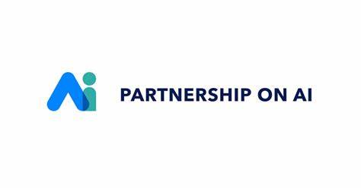

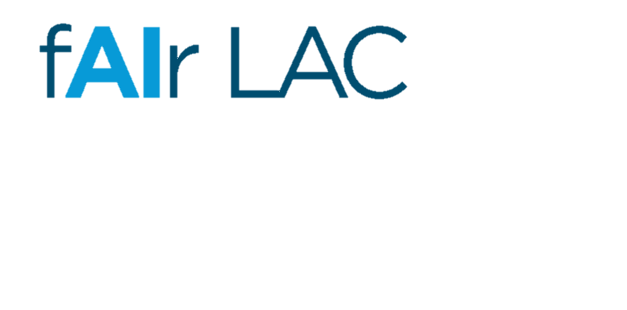
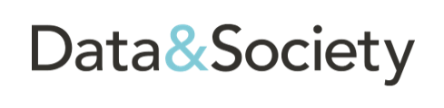



A multi-stakeholder approach and a global dialogue…
Notes:
Let us emphasize that we also need a global dialogue on these issues. No single company, sector of the economy, or discipline will have all the answers on its own.
This multi-stakeholder approach is essential. More broadly, governments, civil society, and industry must come together to ensure that laws, standards, and norms are put in place to guide the responsible use of AI as it becomes an increasingly significant part of our lives.
Microsoft is a founding member of the Partnership on AI, the Rome Call for AI Ethics, and the BID's fAIrLAC initiative, and has actively participated in the work on AI of international organizations such as the OECD and UNESCO.
We collaborate with the best and brightest to advance the industry and society...
OECD
The OECD has facilitated discussions on these topics and adopted AI principles in May 2019. In June 2019, the G20 adopted human-centric AI principles based on the OECD's AI principles. https://www.oecd.org/going-digital/ai/principles/
Partnership on AI
Created by Microsoft and others, the Frontier Model Forum is an industry-led body that develops guidelines for AI developers. The Partnership on AI collaborates with industry leaders, academics, non-profit entities, and practitioners to collectively develop best practices for AI and provide an open platform for discussion and engagement around AI's impact on people and society. As AI policies are considered and take shape globally, Microsoft is taking steps to address the highest-risk or particularly sensitive AI uses.
https://www.partnershiponai.org/
Academic groups, like Data&Society and AINow
+ OpenAI
“Pursue breakthroughs in “general artificial intelligence […] to help solve major challenges in areas such as healthcare, climate change, and education”, See OpenAI Charter
See Microsoft invests $1 billion in OpenAI, vows to build AI tech platform of ‘unprecedented scale’

Slide 47
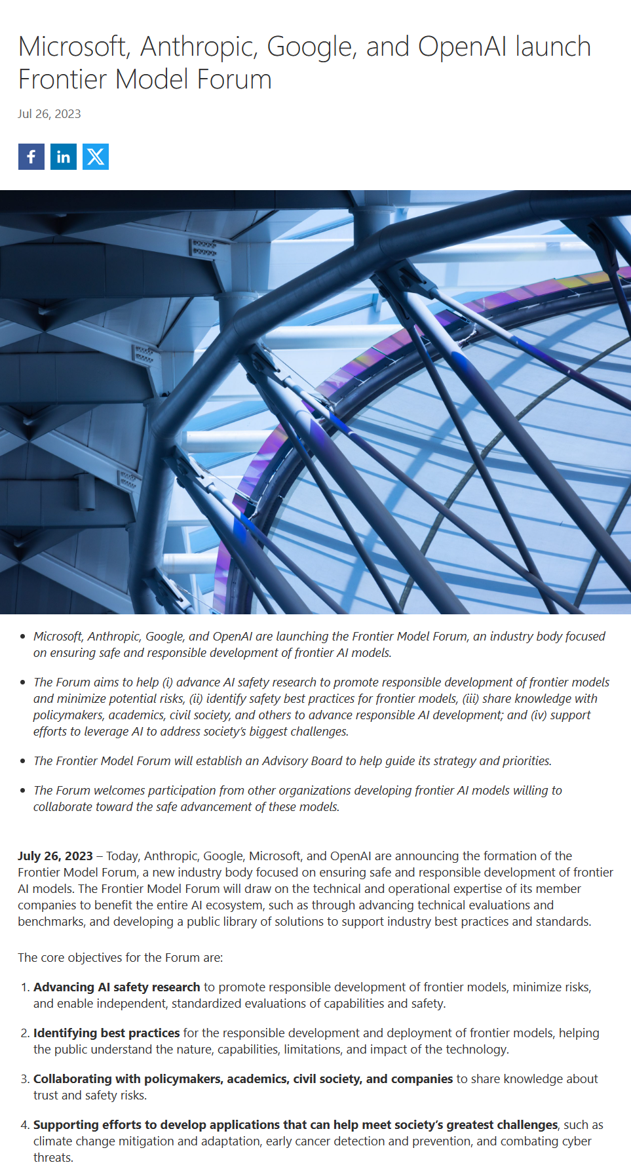
Frontier Model Forum
An industry body focused on ensuring safe and responsible development of frontier AI models.
Advance AI safety research to promote responsible development of frontier models and minimize potential risks
Share knowledge with policymakers, academics, civil society, and others to advance responsible AI development
Establish an Advisory Board to help guide its strategy and priorities
Identify safety best practices for frontier models
Support efforts to leverage AI to address society’s biggest challenges
Welcomes participation from other organizations developing frontier AI models willing to collaborate toward the safe advancement of these models
Notes:
As AI policies are being discussed and adopted across the world, Microsoft takes measures to fill an important gap by focusing on uses of AI that present the highest risks or are particularly sensitive.
At Microsoft, we believe that AI systems controlling operations of high-risk critical infrastructure should be deployed on licensed AI infrastructure. As a member of the Frontier Model Forum—an industry body ensuring the safe and responsible development of cutting-edge AI models—Microsoft will leverage the technical and operational expertise of member companies to benefit the entire AI ecosystem. This includes advancing technical evaluations and benchmarks, developing a public library of solutions to support industry best practices and standards, and ensuring fair and ethical access to these models.
Links:
Microsoft, Anthropic, Google, and OpenAI launch Frontier Model Forum - Microsoft On the Issues:

Slide 48
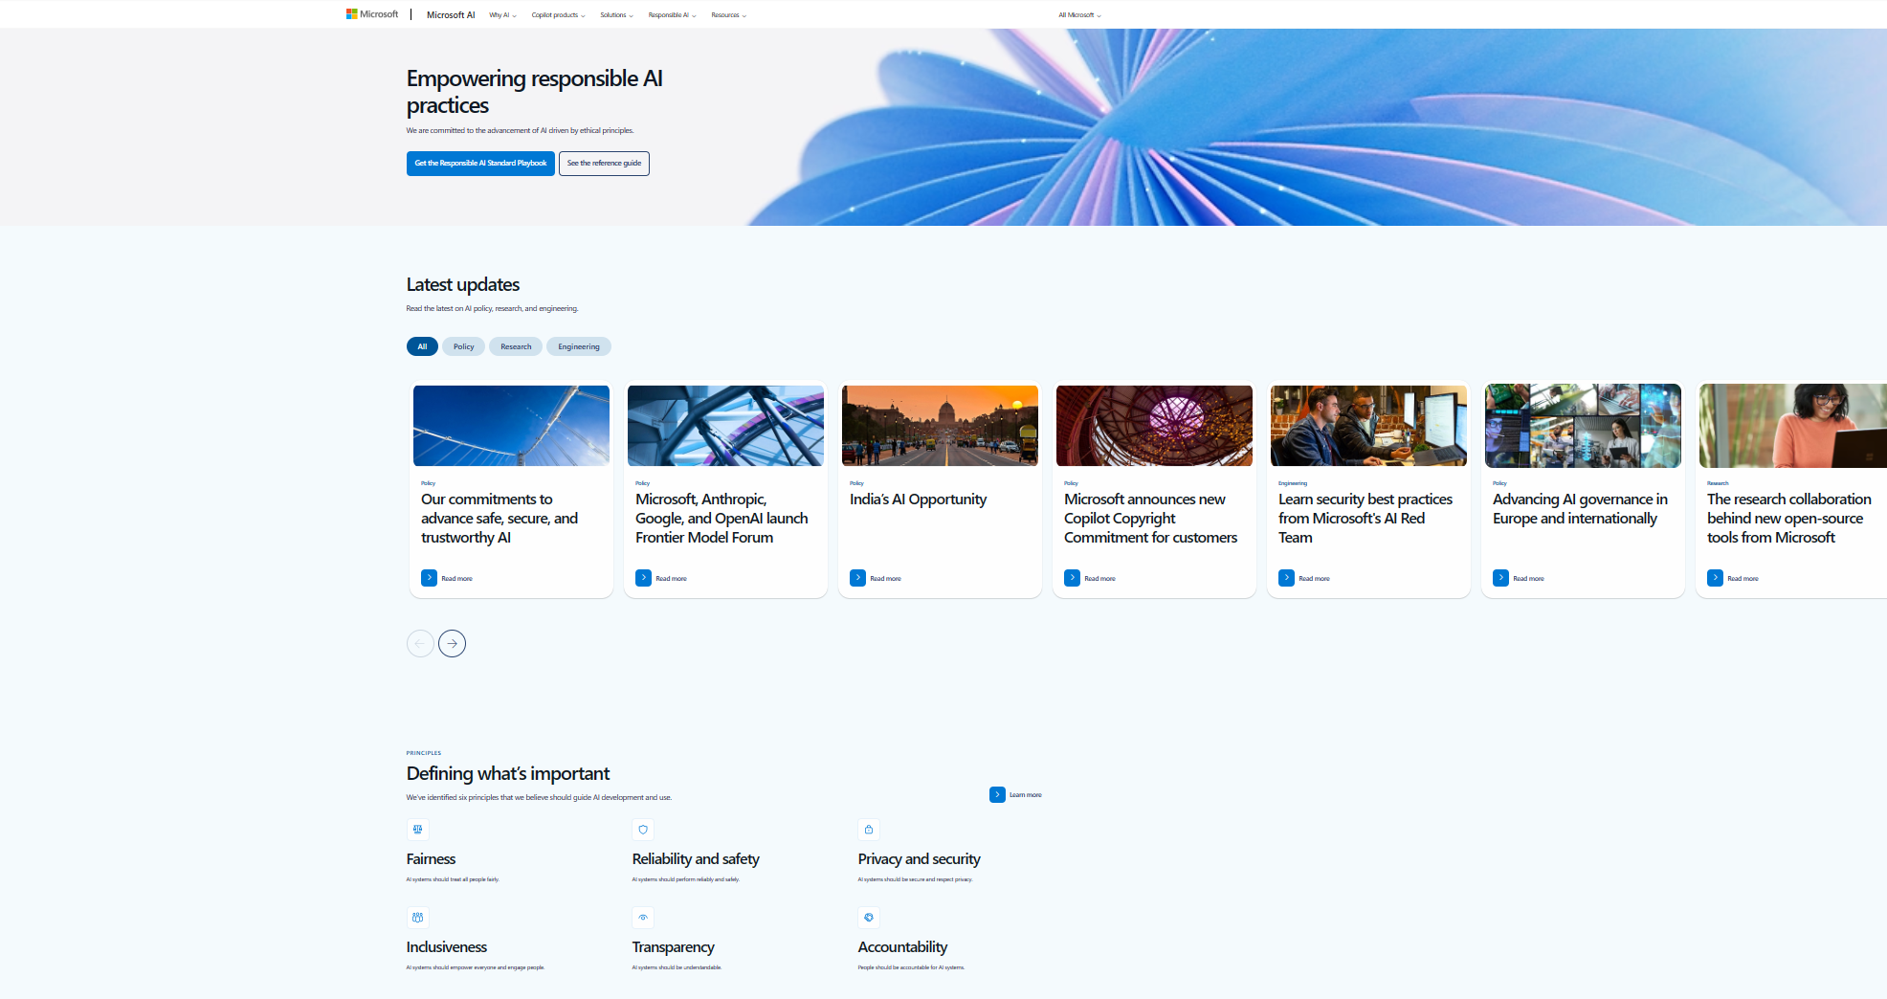
https://aka.ms/RAI
Notes:
You can find our standard and many of the resources provided on this site : https://aka.ms/RAI.

Slide 49
Quiz
What is the title of the book by Brad Smith and Carol Ann Brown?
Notes:
What is the title of the book by Brad Smith and Carol Ann Brown?

Slide 50
Microsoft resources for Responsible AI (tools and practices)

Slide 51
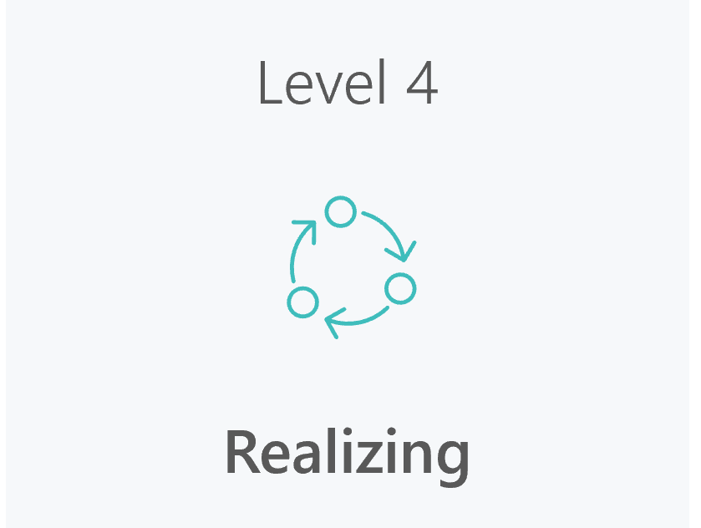
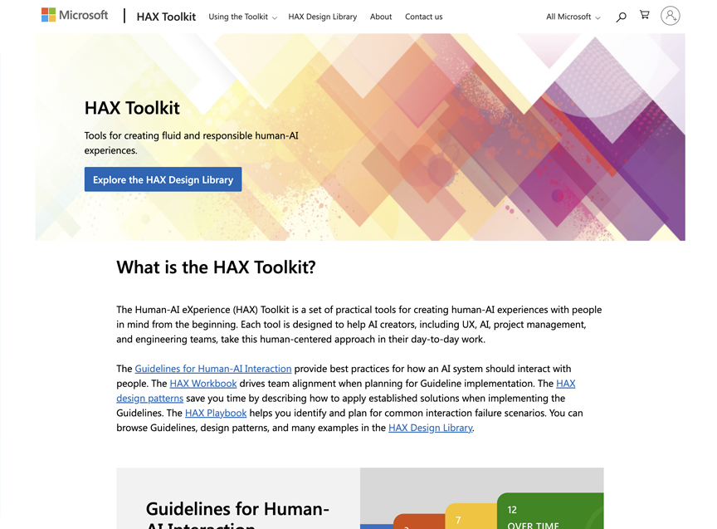
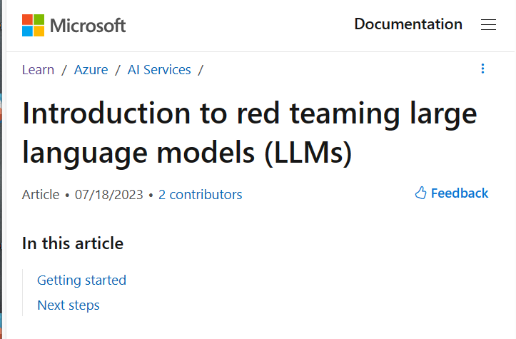
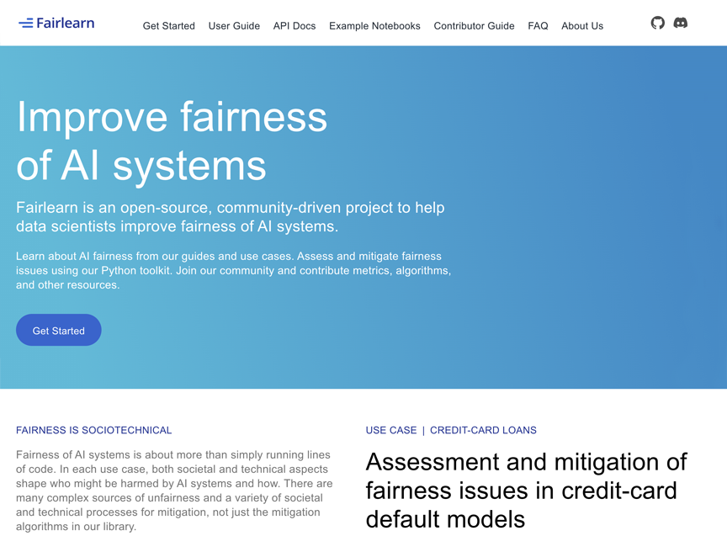
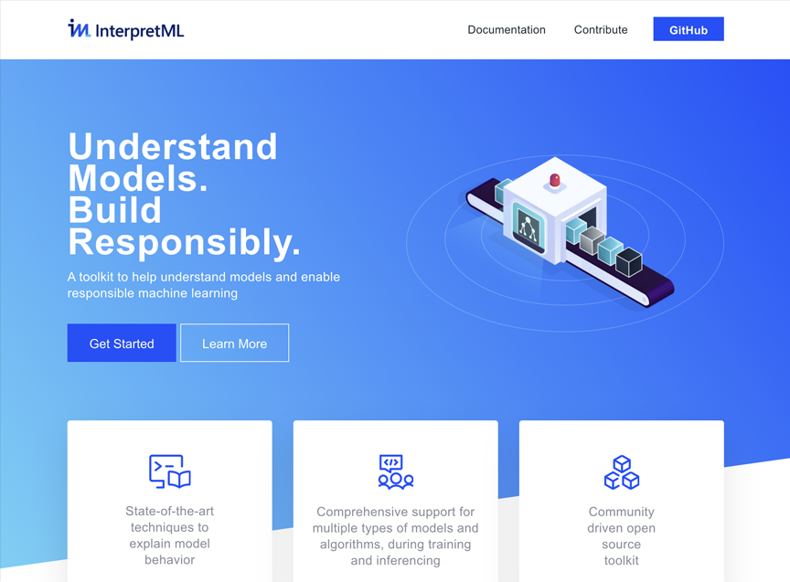
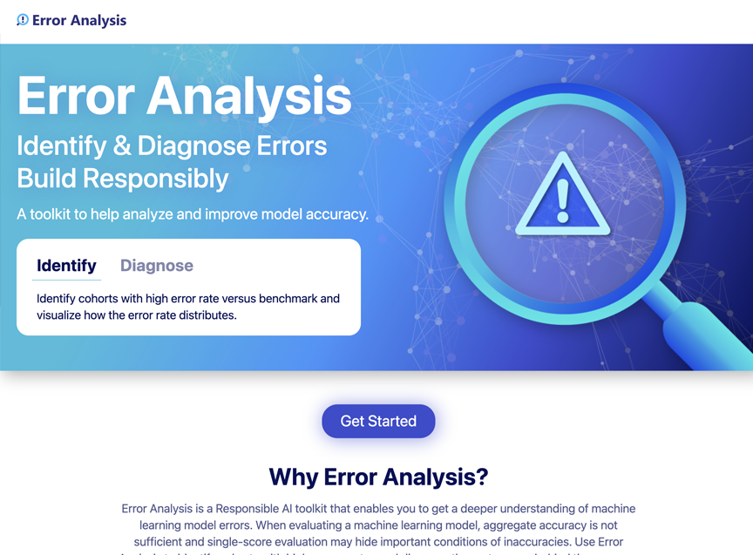
Responsible AI tools and practices
RAI Maturity Model
HAX Toolkit
Guide: Red-teaming LLMs
Fairlearn
InterpretML
Error Analysis
Notes:
As we deploy our responsible AI program across the company, teams often ask about the existence of engineering systems and tools to help us meet our commitments. It is therefore necessary to provide teams with the results of cutting-edge research, practical advice, and innovative tools - from the beginning of development so that others can be inspired by them and use them on a large scale, thus creating a virtuous circle.
The goal is to develop tools, models, and reproducible practices as much as possible, so that the creative thinking of our engineering teams can be directed towards new and unique challenges, instead of reinventing the wheel to instrument their work. In addition, integrated systems and tools contribute to consistency and ensure that responsible AI is part of the "coding path" - it is part of the daily working method of our engineering teams.
To meet this need, we have launched an initiative to build the "paved road" of responsible AI at Microsoft. We are setting up a set of tools, models, and practices that help teams easily integrate the requirements of responsible AI into their daily development practices.
We have already made some of our early work available in the form of toolkits or libraries available in open source. This tooling is also integrated into Azure Machine Learning, our AI development platform, to serve as the foundation for this "paved road," so our customers will also benefit from our development of engineering systems and tools in an integrated form ready for use.
Links:
Azure/counterfit: a CLI that provides a generic automation layer for assessing the security of ML models (github.com): https://github.com/Azure/counterfit
microsoft/responsible-ai-toolbox: Responsible AI Toolbox is a suite of tools providing model and data exploration and assessment user interfaces and libraries that enable a better understanding of AI systems. These interfaces and libraries empower developers and stakeholders of AI systems to develop and monitor AI more responsibly, and take better data-driven actions. (github.com): https://github.com/microsoft/responsible-ai-toolbox
py-why/EconML: ALICE (Automated Learning and Intelligence for Causation and Economics) is a Microsoft Research project aimed at applying Artificial Intelligence concepts to economic decision making. One of its goals is to build a toolkit that combines state-of-the-art machine learning techniques with econometrics in order to bring automation to complex causal inference problems. To date, the ALICE Python SDK (econml) implements orthogonal machine learning algorithms such as the double machine learning work of Chernozhukov et al. This toolkit is designed to measure the causal effect of some treatment variable(s) t on an outcome variable y, controlling for a set of features x. (github.com): https://github.com/py-why/econml
The HAX Toolkit Project - Microsoft Research: https://www.microsoft.com/en-us/research/project/hax-toolkit/

Slide 52
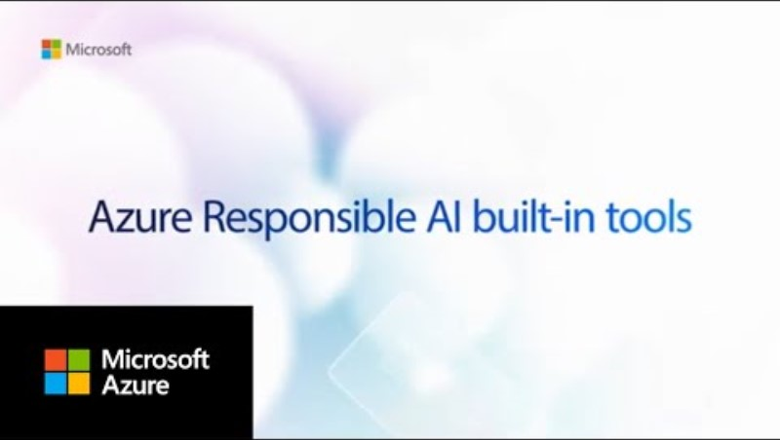
Responsible AI tools and practices
Notes:
Let’s look at it in a video ! ;-)
Links:
https://youtu.be/VNM7wQC_BRU?si=xpUGZsateM4t_BK7

Slide 53
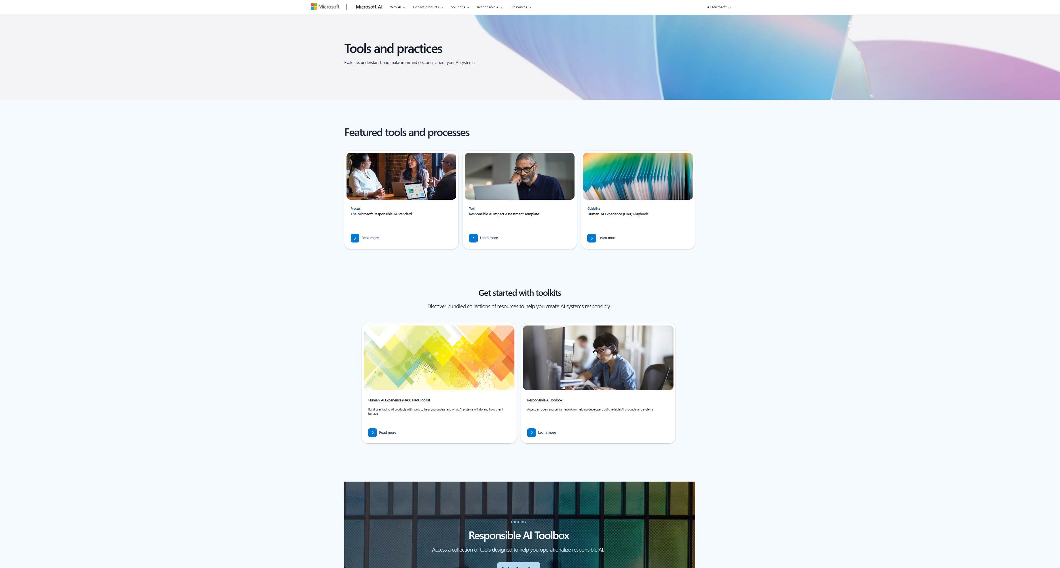

Visit https://aka.ms/RAIresources to get started

Slide 54
A quick recap! ;-)
AI innovation is occurring at a rapid pace today and companies are accelerating adoption of AI.
Societal and environmental expectations are evolving, and governments are regulating AI in response.
Organizations should therefore consider adopting a Responsible AI approach to harness the power of AI in a way which mitigates risks and is compliant.
Responsible AI is both is a culture and a practice to make sure that AI systems are trustworthy and uphold an organization’s AI principles.
Microsoft is helping customers put responsible AI into practice by building custom mitigations into our AI products, sharing our learnings and perspective, and providing purpose-built tooling to support customers that want to build their own solutions responsibly.
Notes:
Ultimately, we believe that every organization that creates or uses advanced AI systems will need to develop and implement its own AI governance systems. To be effective, these systems must go beyond standards and principles and invest in real-world tools and practices to support teams throughout the AI development lifecycle.
Providing end-to-end tools and guidance for the responsible deployment of generative AI is a top priority for Microsoft.

Slide 55
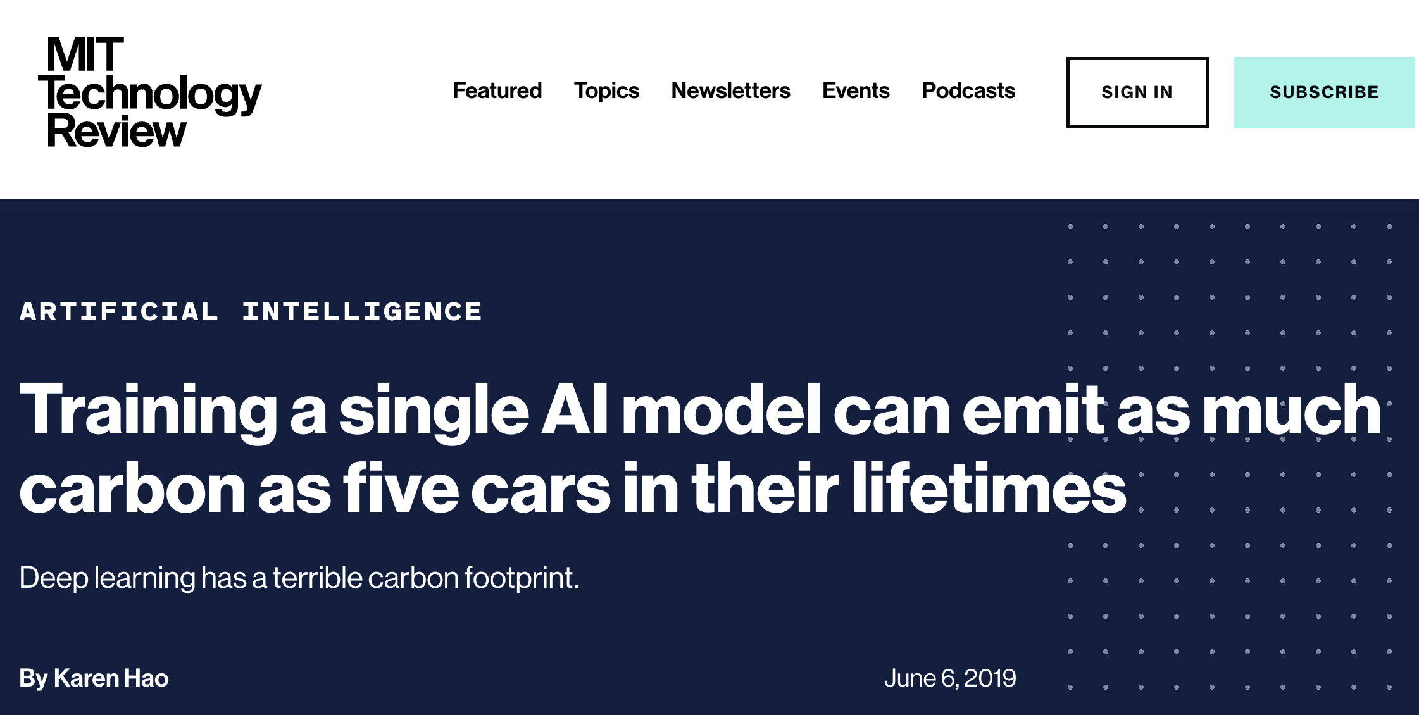
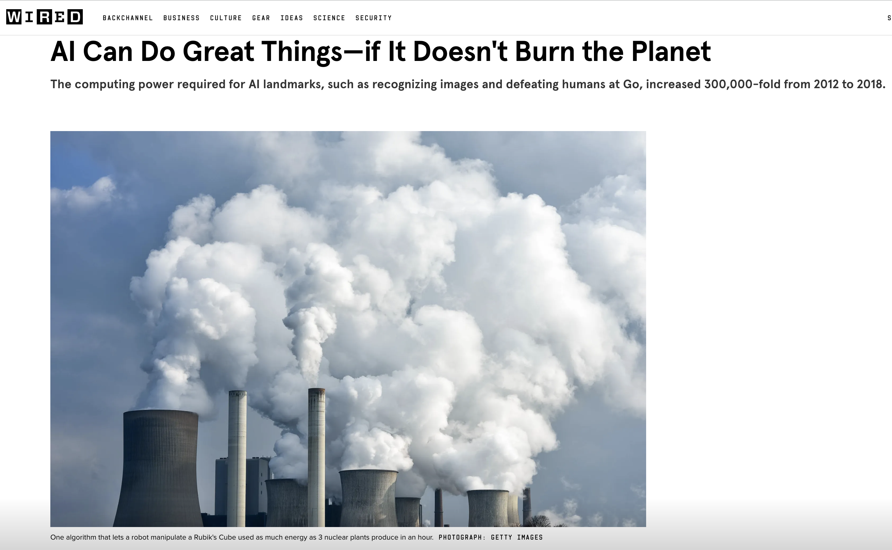
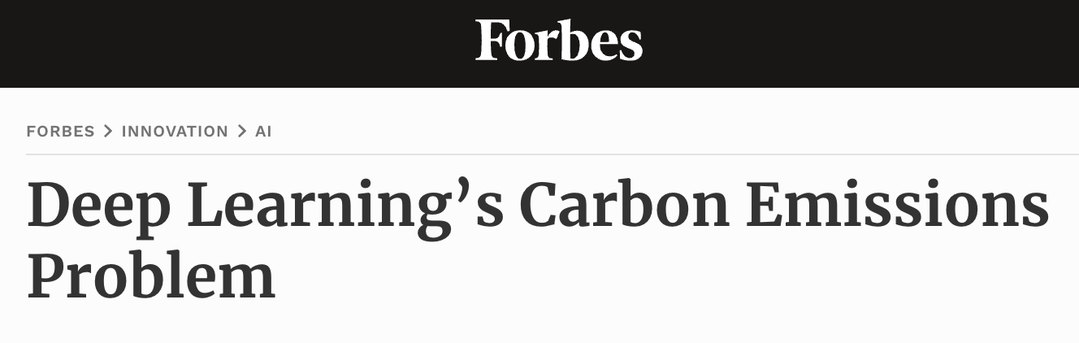
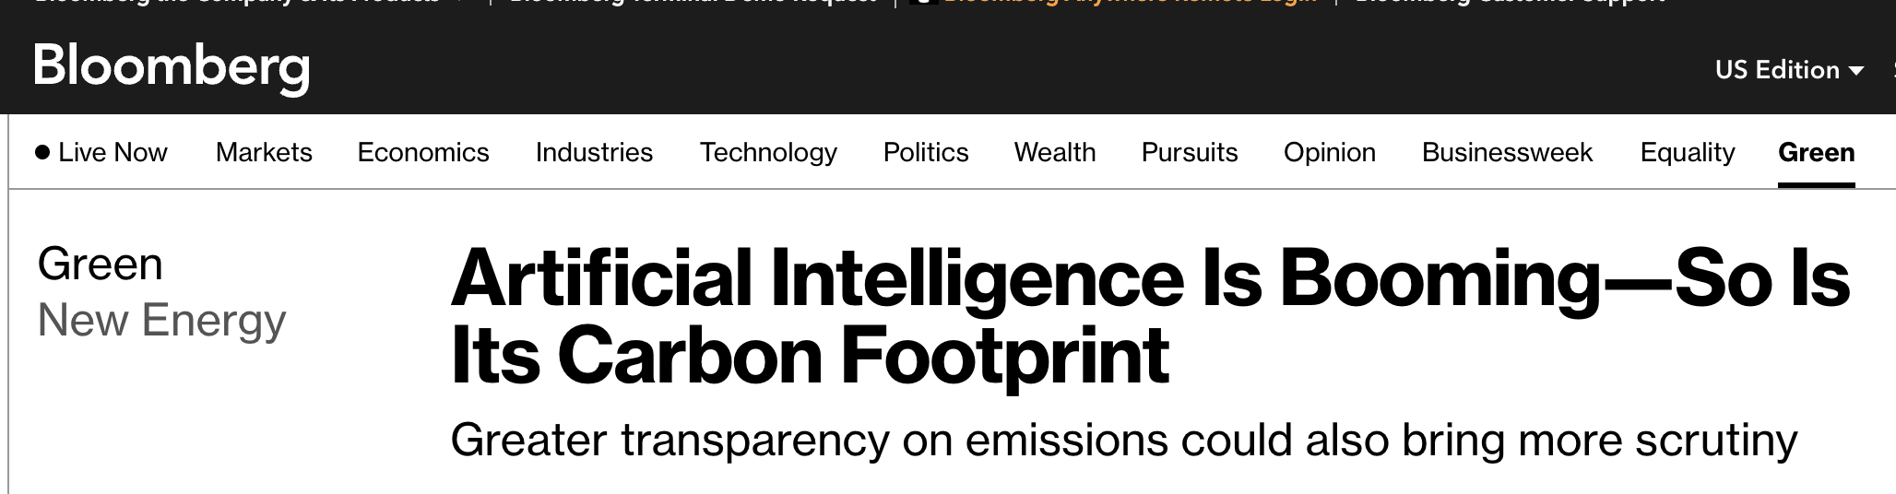





A new topic Environmentally responsible AI

Slide 56

Framing
GreenAI ("Sustainable AI") vs. Green with AI ("Sustainability enabled by AI")
Do the benefits of a technology outweigh the costs/impacts?
Costs: development (training), operation (inference), embodied carbon (hardware), storage (data)
Benefits: AI used to accelerate decarbonization progress

Slide 57




/learn
Review content covered in this module
aka.ms/learnlive-20231017FT

Slide 58
Other resources for getting started
TOOLS & PRODUCT DOCUMENTATION
Azure AI Content Safety (website)
What is Azure AI Content Safety?
Harm categories
Transparency Note
Azure OpenAI Service (website)
How to fine-tune a model for your use case
How to use built-in content filters
Ground models with your own data
Prompt engineering techniques
Transparency Note
Azure Machine Learning (website)
Discover, fine-tune and evaluate models in the model catalog
Ground foundation models using prompt flow
Build metaprompts using prompt flow
Submit bulk test and evaluate a flow in prompt flow
Develop a custom evaluation flow in prompt flow
Enterprise security and governance
GUIDES & LEARNING
Microsoft’s Responsible AI foundations
Responsible AI Standard v2
Responsible AI Impact Assessment Template
HAX Playbook
Responsible AI for generative AI
Overview: Responsible AI for generative AI
Mitigate potential harms
Introduction to prompt engineering
Advanced prompt engineering techniques
Red teaming LLMs
Operationalize your mitigations
Learning modules
Microsoft AI - Learning and Community Hub
Develop Generative AI solutions with Azure OpenAI Service
Fine-tune a foundation model in Azure Machine Learning
Microsoft on the Issues
How do we best govern AI?
Reflecting on our responsible AI program
Our commitments to advance safe, secure, and trustworthy AI
Announcing the Frontier Model Forum
Notes:
Today, we have a wide range of different resources to help you get started, wherever you are on your journey with generative AI.
Azure AI Content Safety is an Azure service that powers the built-in safety systems we talked about in Azure OpenAI and Azure Machine Learning. You can also use it as a standalone content moderation service for your application.
Then there's Azure OpenAI Service, which has the latest and most powerful OpenAI models, which incorporate safety. Azure OpenAI also makes it easier to build meta-prompts and base models into your own data.
Azure Machine Learning is our comprehensive machine learning platform, where you'll find the model catalog, including the leading models from Azure OpenAI, Hugging Face, and Meta. You will also find fine-tuning tools and a prompt flow that will help you build your meta-prompt and anchor your model in data sources, as well as run all those interesting assessments to see if your system is working as intended. On the right side, you will also find links to other general resources we talked about, like Microsoft's responsible AI standard and the HAX toolkit. We also provide more information on mitigation layers and techniques such as rapid engineering and red teaming.
We are constantly enriching our catalog of online learning courses, and some courses include labs that allow you to gain hands-on experience. As you may have noticed throughout today's presentation, we believe that hands-on learning is the best way to learn and foster collaboration and innovation in the age of AI.

Slide 59


Microsoft's first annual Responsible AI transparency report
How we build generative AI applications responsibly
How we make decisions about releasing generative AI applications
How we support our customers as they build generative AI applications
How we learn, evolve and grow
https://aka.ms/RAITransparencyReport2024
Notes:
As a company at the forefront of AI research and technology, we are committed to sharing our responsible AI practices with the public as they evolve. In this Transparency Report, we share our maturing practices, reflect on what we have learned, and present our goals to hold ourselves accountable and earn public trust.
Links:
https://aka.ms/RAITransparencyReport2024

